Slide 1

Vortex RISC-V GPGPU Presentation
Sponsored by
Supervisors
Dr. Diaa Eldin Khalil
Dr. Hossam Hassan

Slide 2
Presented by
Abdelhmed Mahmoud | 21P0171
Abdullah Ahmed Youssef | 2100369
Ahmed Mostafa Gomaa | 21P0407
Amir Raed | 21P0380
Eiz Eldeen Housam | 21P0170
Mark Maher | 21P0355
Sama Ashraf | 21P0066
Youssef Khaled | 22P0278

Slide 3
Outlines:
Introduction
Motivation
Architecture
ASIC Implantation
Verification Plan and Results
Future Work

Slide 4
Introduction
What does GPGPU stand for ?
GPGPU stands for General Purpose Graphic Processing Unit.
Why would we use it?
It is a general-purpose processing unit which provides a high parallel computation capability.

Slide 5

Introduction
Vortex RISC-V:
Open-source hardware and software platform for (GPGPUs), built on the open RISC-V instruction set architecture (ISA).

Slide 6
Introduction
Architecture: Single-Instruction Multiple-Threads (SIMT) execution model.
Vortex includes a full compiler, driver and runtime. It supports high-capability debugging.

Slide 7
Motivation
Why bother with GPGPUs instead of just having regular cores processor ?
Used for regular tasks that are ordinary CPU alike and that is why it is called General Purpose.
High parallel computational capability feature suitable for AI and ML training.
HW/SW Co-design is a great motive to adopt the thought of GPGPUs.

Slide 8
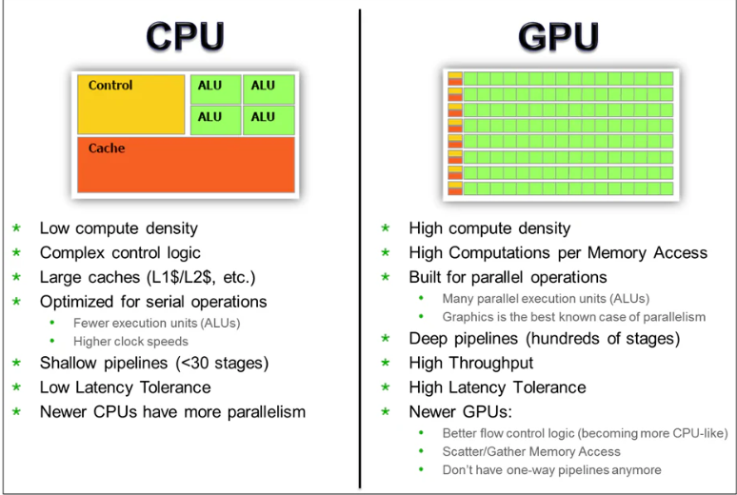
CPU VS GPU

Slide 9
Overview on RISC V Architecture

Slide 10
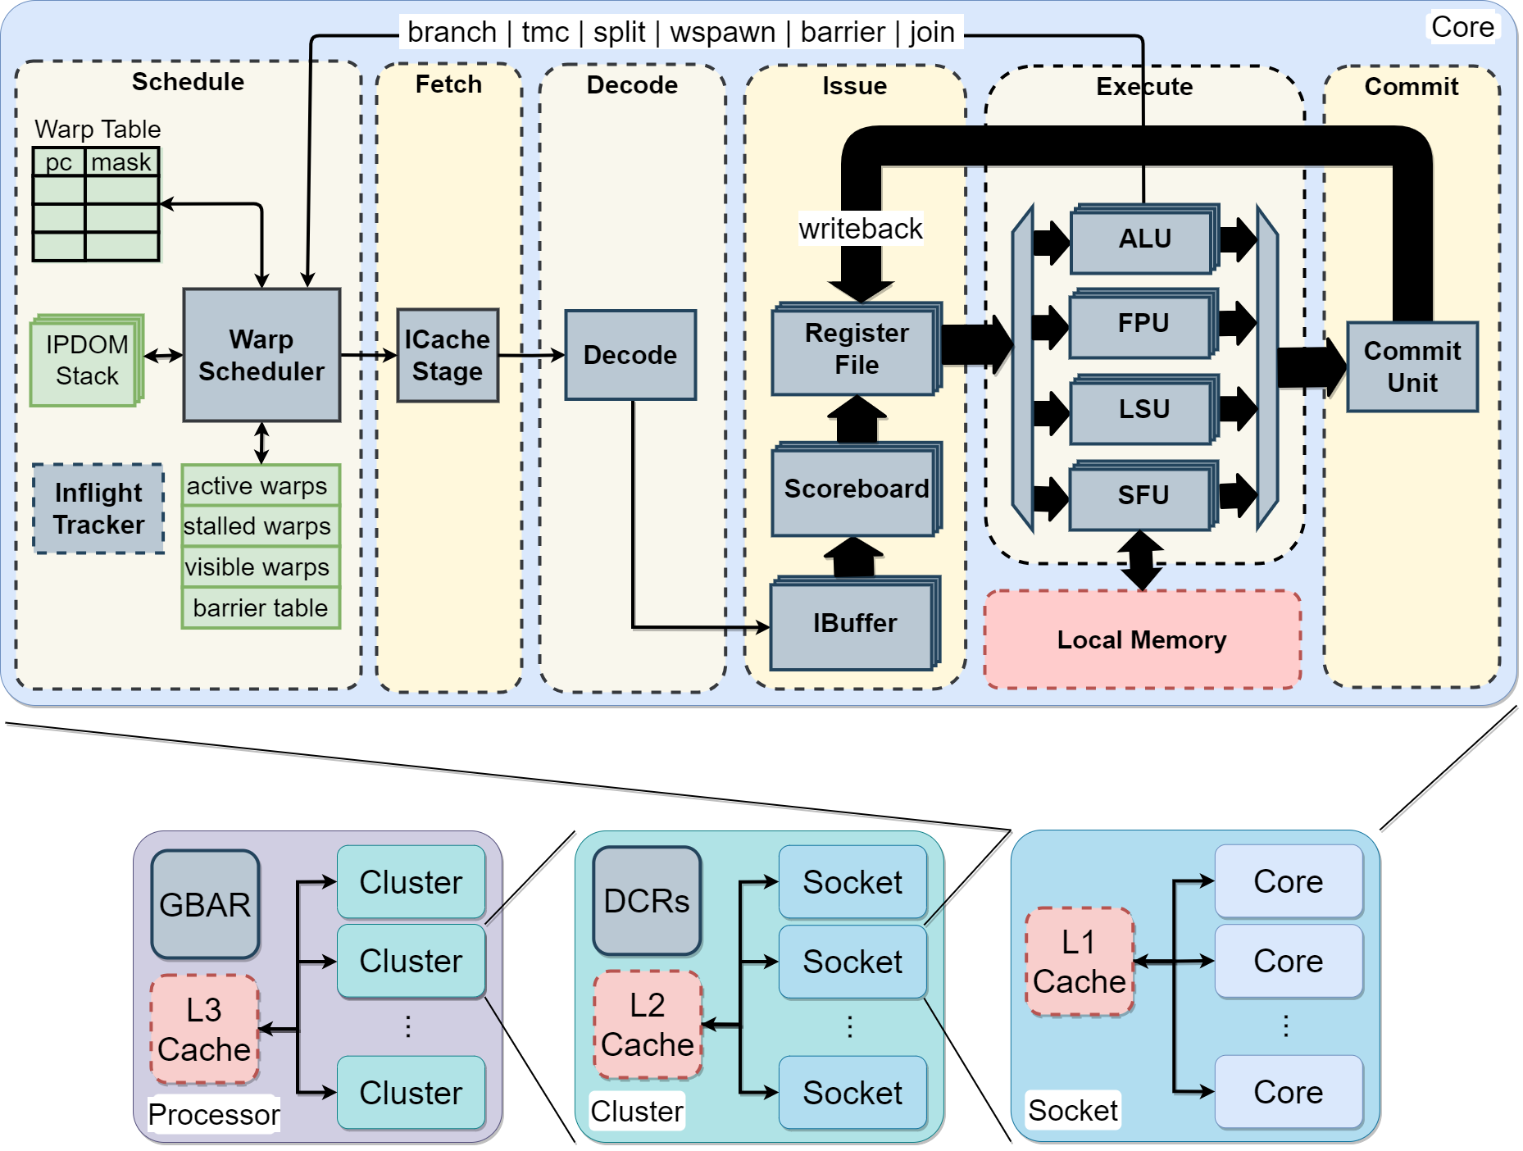
RISC-V GPGPU Architecture
The Vortex architecture follows a hierarchical SIMT execution model with configurable parameters for cores, warps, and threads. The 6-stage pipeline (Schedule → Fetch → Decode → Issue → Execute → Commit) processes instructions through specialized execution units.

Slide 11
RISC-V GPGPU Architecture
Schedule
Warp Scheduler
Schedule the next PC into the pipeline
Track stalled, active warps
Fetch
Retrieve instructions from memory
Handle I-cache requests/responses

Slide 12
RISC-V GPGPU Architecture
Decode
Decode fetched instructions
Notify warp scheduler on control instructions
Issue
IBuffer
Store decoded instructions in separate per-warp queues
Scoreboard
Track in-use registers
Check register use for decoded instructions
Operands Collector
Fetch the operands for issued instructions from the register file

Slide 13
RISC-V GPGPU Architecture
Execute
ALU Unit
Handle arithmetic and branch operations
FPU Unit
Handle floating-point operations
LSU Unit
Handle load/store operations
SFU Unit
Handle warp control operations
Commit
Write result back to the register file and update the Scoreboard.

Slide 14
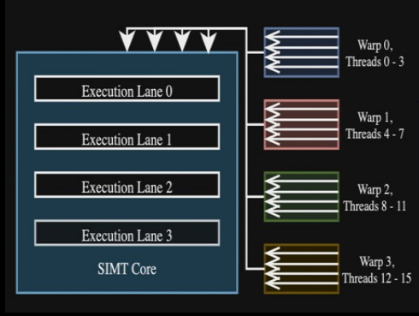
RISC-V GPGPU Architecture
Compute Units Hierarchy
Threads Smallest unit of computation
Warps A logical group of threads
Cores group of warps
Sockets Grouping multiple cores
Clusters Grouping of sockets

Slide 15
RISC-V GPGPU Architecture
Memory Hierarchy
Vortex implements a multi-level cache hierarchy (L1, L2, L3) plus local shared memory. The memory system includes:
L1 instruction and data caches per core
L2 cache shared within clusters
L3 cache at the top level
local shared memory: Shared by all warps in a workgroup

Slide 16
Single Instruction Multiple Threads

Slide 17
Single Instruction Multiple Threads
Outlines:
SIMD
Threads
Warps
SIMT Vs SIMD

Slide 18
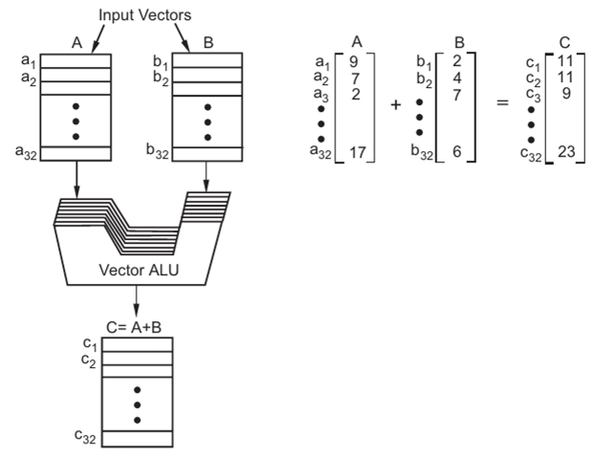
SINGLE INSTRUCTION MULTIPLE DATA

Slide 19
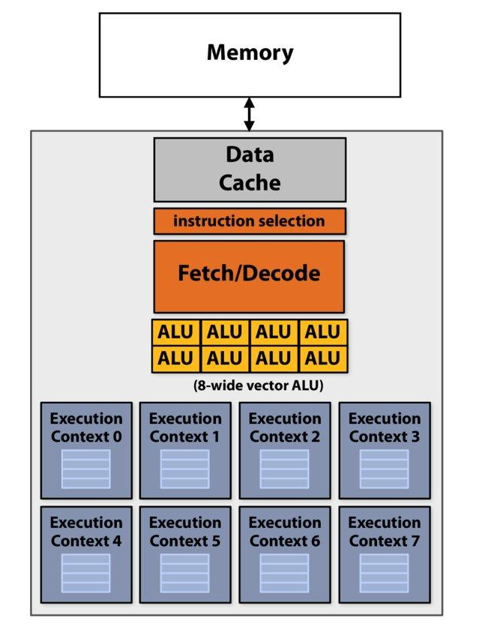
Threads
Each thread has its own Program Counter and registers.
Each thread has its own execution unit.
However, they share the rest of the core.

Slide 20
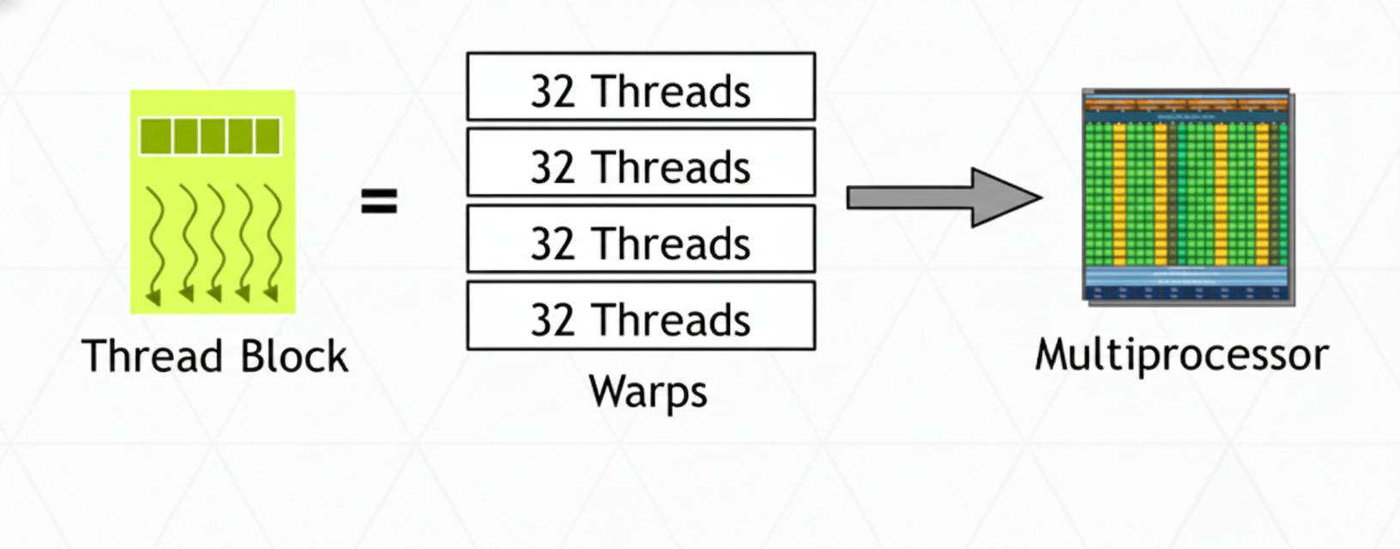
Warps
Threads are organized into groups of threads called “warps”
All threads within a warp execute the same instruction simultaneously

Slide 21
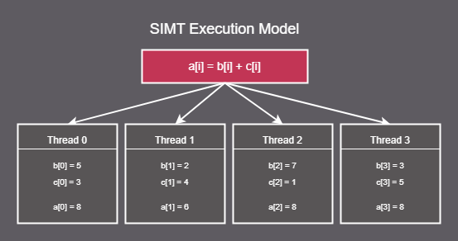
Threads and Warps Example

Slide 22
SIMD vs SIMT
Features | SIMD | SIMT
Registers | Vector registers | Per-thread registers
Hardware | CPUs, GPUs | GPUs
Parallelism Type | Data-level parallelism | Task-level parallelism
Programming Complexity | Higher | Lower
Complexity | Lower | Higher
Divergence Handling | Not applicable | Performance loss in diverging warps

Slide 23
Scheduling Stage

Slide 24
Scheduling Stage
Outlines:
Purpose
Warp Mask
Branch Divergence
IPDOM Stack
Barriers

Slide 25
Purpose
Selects one eligible warp each cycle using round robin and provide its PC and thread mask context to the fetch stage.
Integrates IPDOM stack to support divergence/reconvergence with split/join operations.
Blocks warps and threads at barriers until all arrive.
Timeout counter detects deadlock on prolonged stalls.
If branching is used warp table PC: target or PC+4

Slide 26
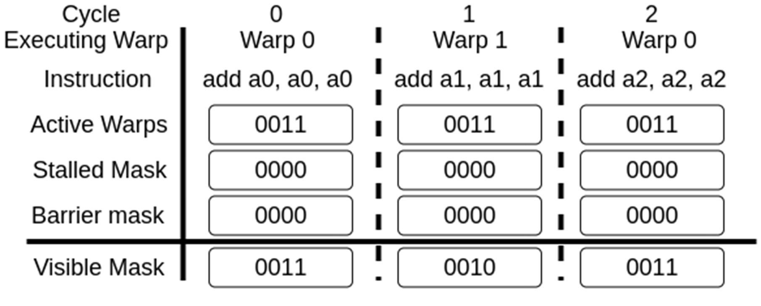
Warp Mask
Active (ready to use)
Stalled (waiting for the memory or to decode)
Barrier (synchronizer)
Visible (statues)

Slide 27
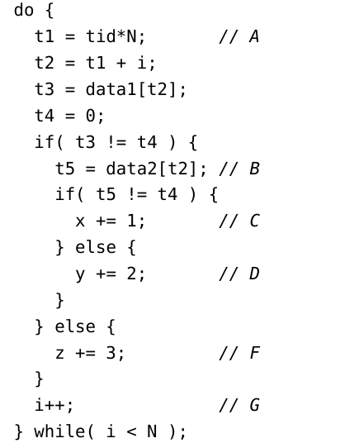
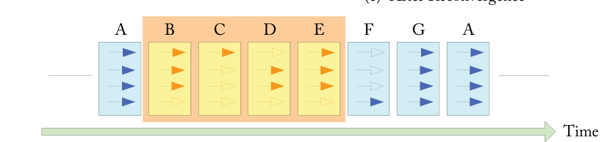
Branch Divergence

Slide 28
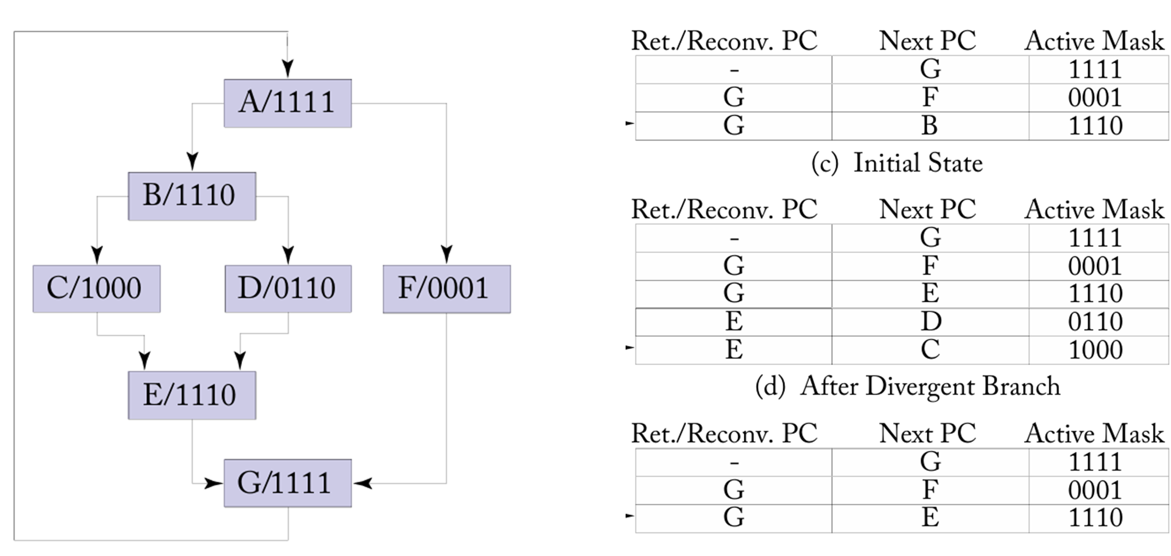
IPDOM Stack

Slide 29
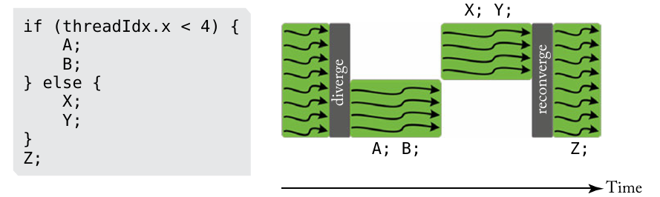
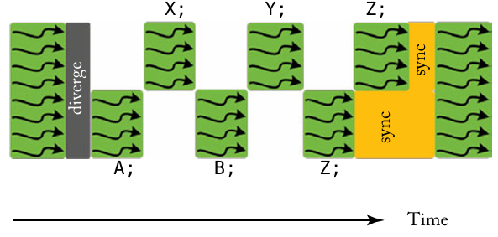
Barriers
Synchronize threads within a single warp or workgroup
We can see that threads ‘A" and ‘B’ arrived earlier
Which will decrease the efficiency of task “z”

Slide 30
Fetch Stage

Slide 31
Fetch Stage
Outlines:
Role & Context: Where does the Fetch Stage fit?
Architecture & Data Flow: Key components and interfaces.
Core Operation: The request-response cycle.

Slide 32
Role & context
Primary Responsibility: Retrieve instructions from the Instruction Cache (I-Cache) for warps selected by the scheduler.
Key Characteristic: Purely a memory interface stage, it does not decode or interpret instructions; it simply moves them.
Key Challenge: It must manage multiple in-flight requests for different warps and correctly reassemble the data, acting as a stateful bridge between the scheduler and memory system.

Slide 33
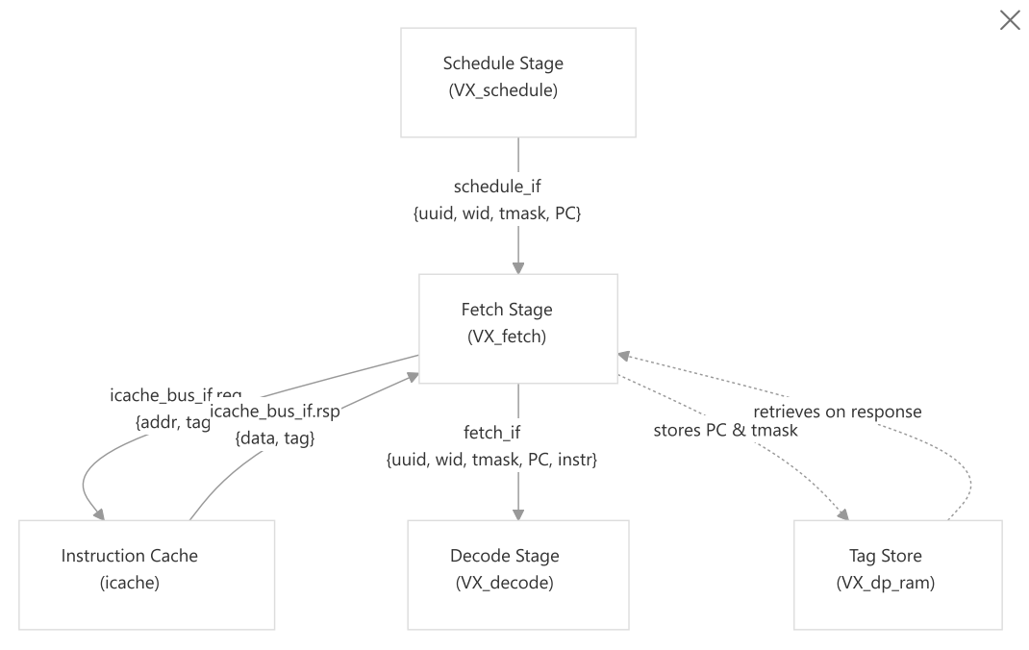
Architecture & Data Flow
Schedule Interface (Input)
uuid: Unique instruction identifier for tracking
wid: Warp ID (which warp is being scheduled)
tmask: Thread mask indicating which threads are active
PC: Program counter (address of the instruction to fetch)
Fetch Interface (Output)
uuid: (passed through)
wid: (passed through)
tmask: (passed through)
PC: (passed through)
instr: instruction word fetched from memory

Slide 34
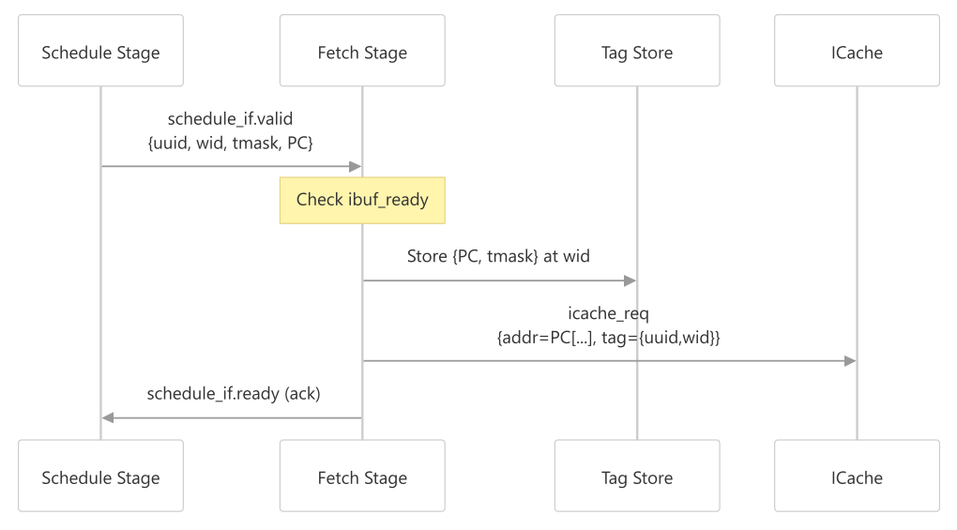
Core Operation (1)
Request Generation:
When a valid warp is scheduled, the fetch stage generates an icache request
The request includes:
Address: Extracted from the PC (4-byte aligned)
Tag: Combines UUID and warp ID for tracking the request

Slide 35
Core Operation (2)
Tag Storage :
The fetch stage stores the PC and thread mask in a dual-port RAM indexed by warp ID. This is necessary because icache responses may arrive out-of-order
The tag store is written on every icache request and read when responses arrive, allowing the fetch stage to reconstruct the full fetch information.

Slide 36
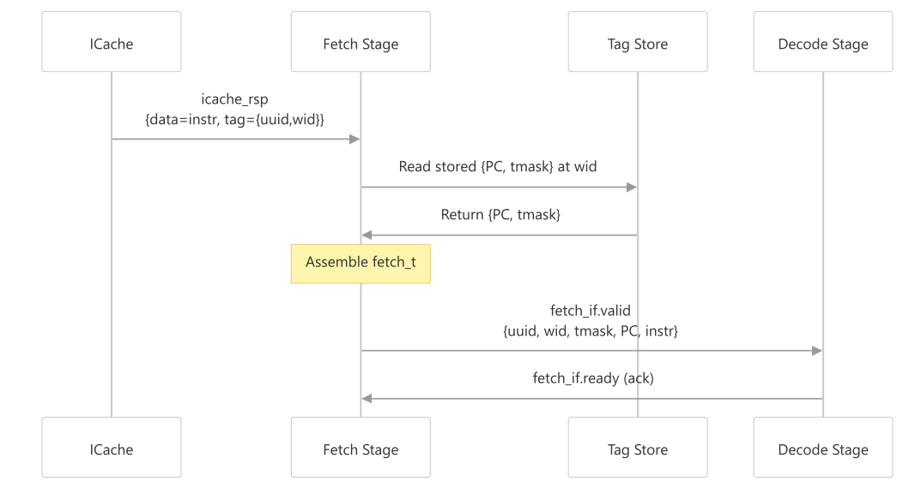
Core Operation (3)
Response Processing :
Extracts the UUID and warp ID from the response tag
Retrieves the stored PC and thread mask from the tag store
Assembles the complete fetch_t structure
Outputs it to the decode stage

Slide 37
Key Challenges (1)
Request Buffering
Requests are buffered through an elastic buffer before being sent to the icache bus.
This decouples the fetch stage from icache timing and helps maintain throughput.
Prevent Pipeline Deadlock Especially when:L1 cache is disabled or I-cache and D-cache share the same bus
IBUF flow control: Limits outstanding fetches per warp, Prevents buffer overflow and Avoids circular stalls

Slide 38
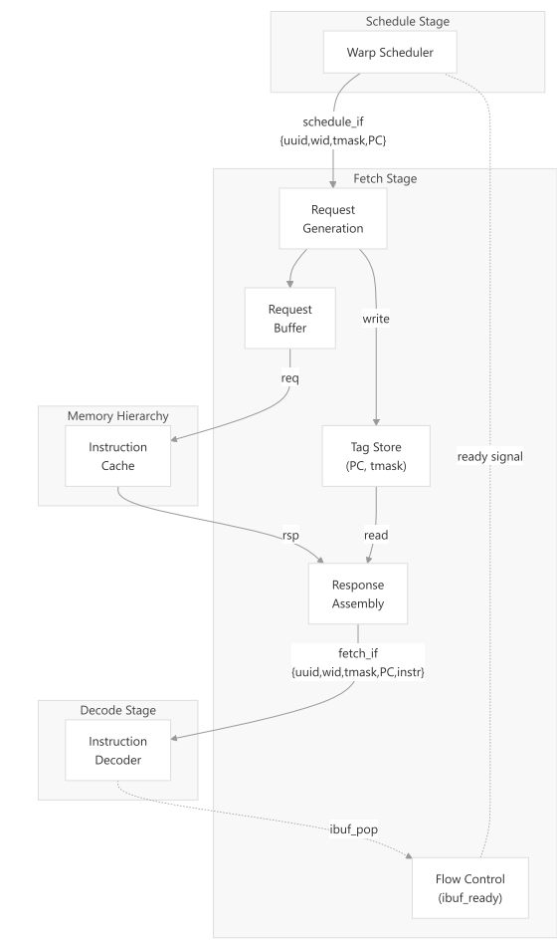
Key Challenges (2)
Complete Data Flow Diagram
When L1 cache is disabled, the fetch stage implements flow control to prevent the instruction buffer (ibuffer) from overflowing.
This mechanism tracks pending fetches per warp and stalls scheduling when a warp's ibuffer is full, preventing deadlock when icache and dcache share the same bus.

Slide 39
Decode Stage

Slide 40
Decode Stage
Outlines:
Role & Context: The translator in the pipeline.
The Decoding Process: A step-by-step walkthrough.
Key Responsibilities: Scheduling hints and flow control.

Slide 41
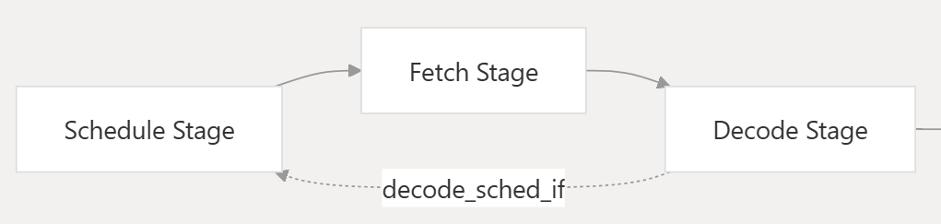
Role & context
Primary Responsibility:
Translates raw instructions into execution-ready control information
Determines:
Execution unit
Operation type
Register operands
Communicates control-flow information back to scheduler
Key Characteristic: It is purely combinational logic. It translates the instruction in a single clock cycle, with no internal state between instructions.

Slide 42
The Decoding Process
Input Interface (fetch_if) uuid, wid, tmask, PC and instr.
Step 1: Extract Instruction Fields The decoder extracts standard RISC-V fields:
opcode (bits 6:0): Primary operation code
Funct_x: Functions codes for operation variants
rd, rs1, rs2, rs3: Register indices

Slide 43
The Decoding Process
Step 2: Decode Immediate Values
Based on instruction type, different immediate formats are extracted:
I-type: 12-bit immediate (with special handling for shift instructions)
S-type: Store immediate
B-type: Branch immediate
U-type: Upper immediate
J-type: Jump immediate

Slide 44
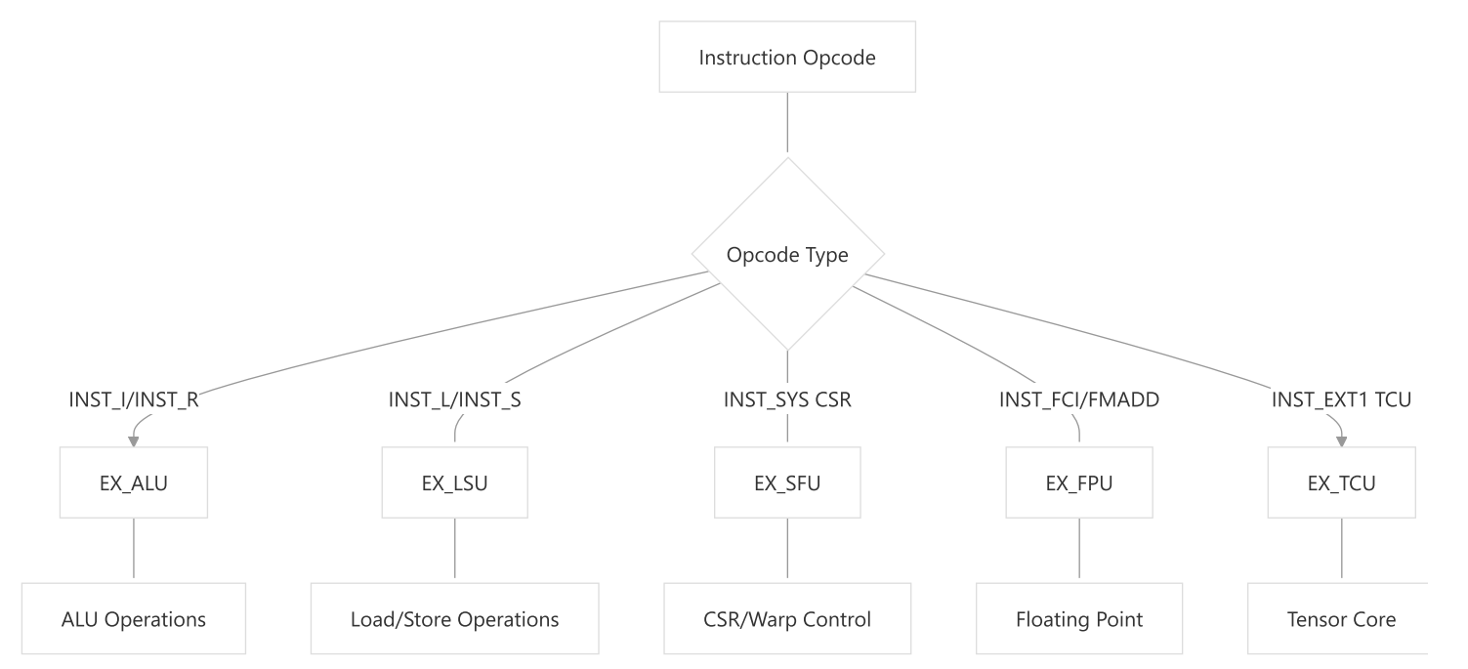
The Decoding Process
Step 3: Determine Execution Unit and Operation Type
The decoder performs a large case statement on the opcode to determine Execution unit

Slide 45
The Decoding Process
Step 4: Identify Register Usage
For each instruction type, the decoder identifies which registers are used.
The USED_IREG and USED_FREG macros mark registers as integer or floating-point registers.
Step 5: Extract Operation-Specific Arguments
The decoder populates the op_args union based on execution unit
Step 6: Detect Warp-Stalling Instructions
Certain control flow instructions cause warp stalls
Instructions like JAL, JALR, branches, and some SFU operations set the is_wstall flag or unlock the warp.

Slide 46
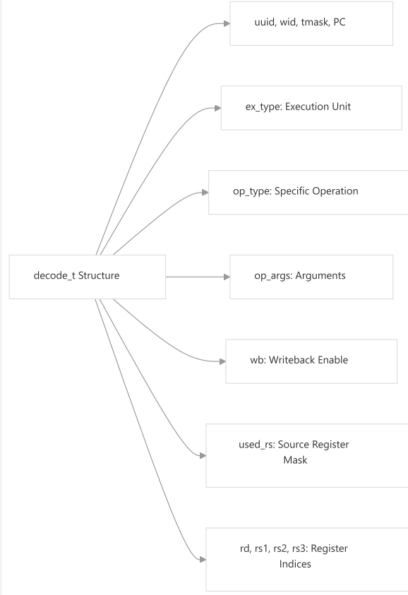
Key Responsibilities
Output Interface (decode_if)
The decode stage outputs a fully decoded decode_t structure

Slide 47
Key Responsibilities
Communication with Scheduler
Signals:
wid: Warp ID
valid: Whether warp can continue
unlock: Whether it must stall
Scheduler Uses This To:
Manage warp state
Avoid incorrect instruction issue
Preserve correct SIMT execution

Slide 48
Issue Stage The Orchestra Behind The Scene

Slide 49
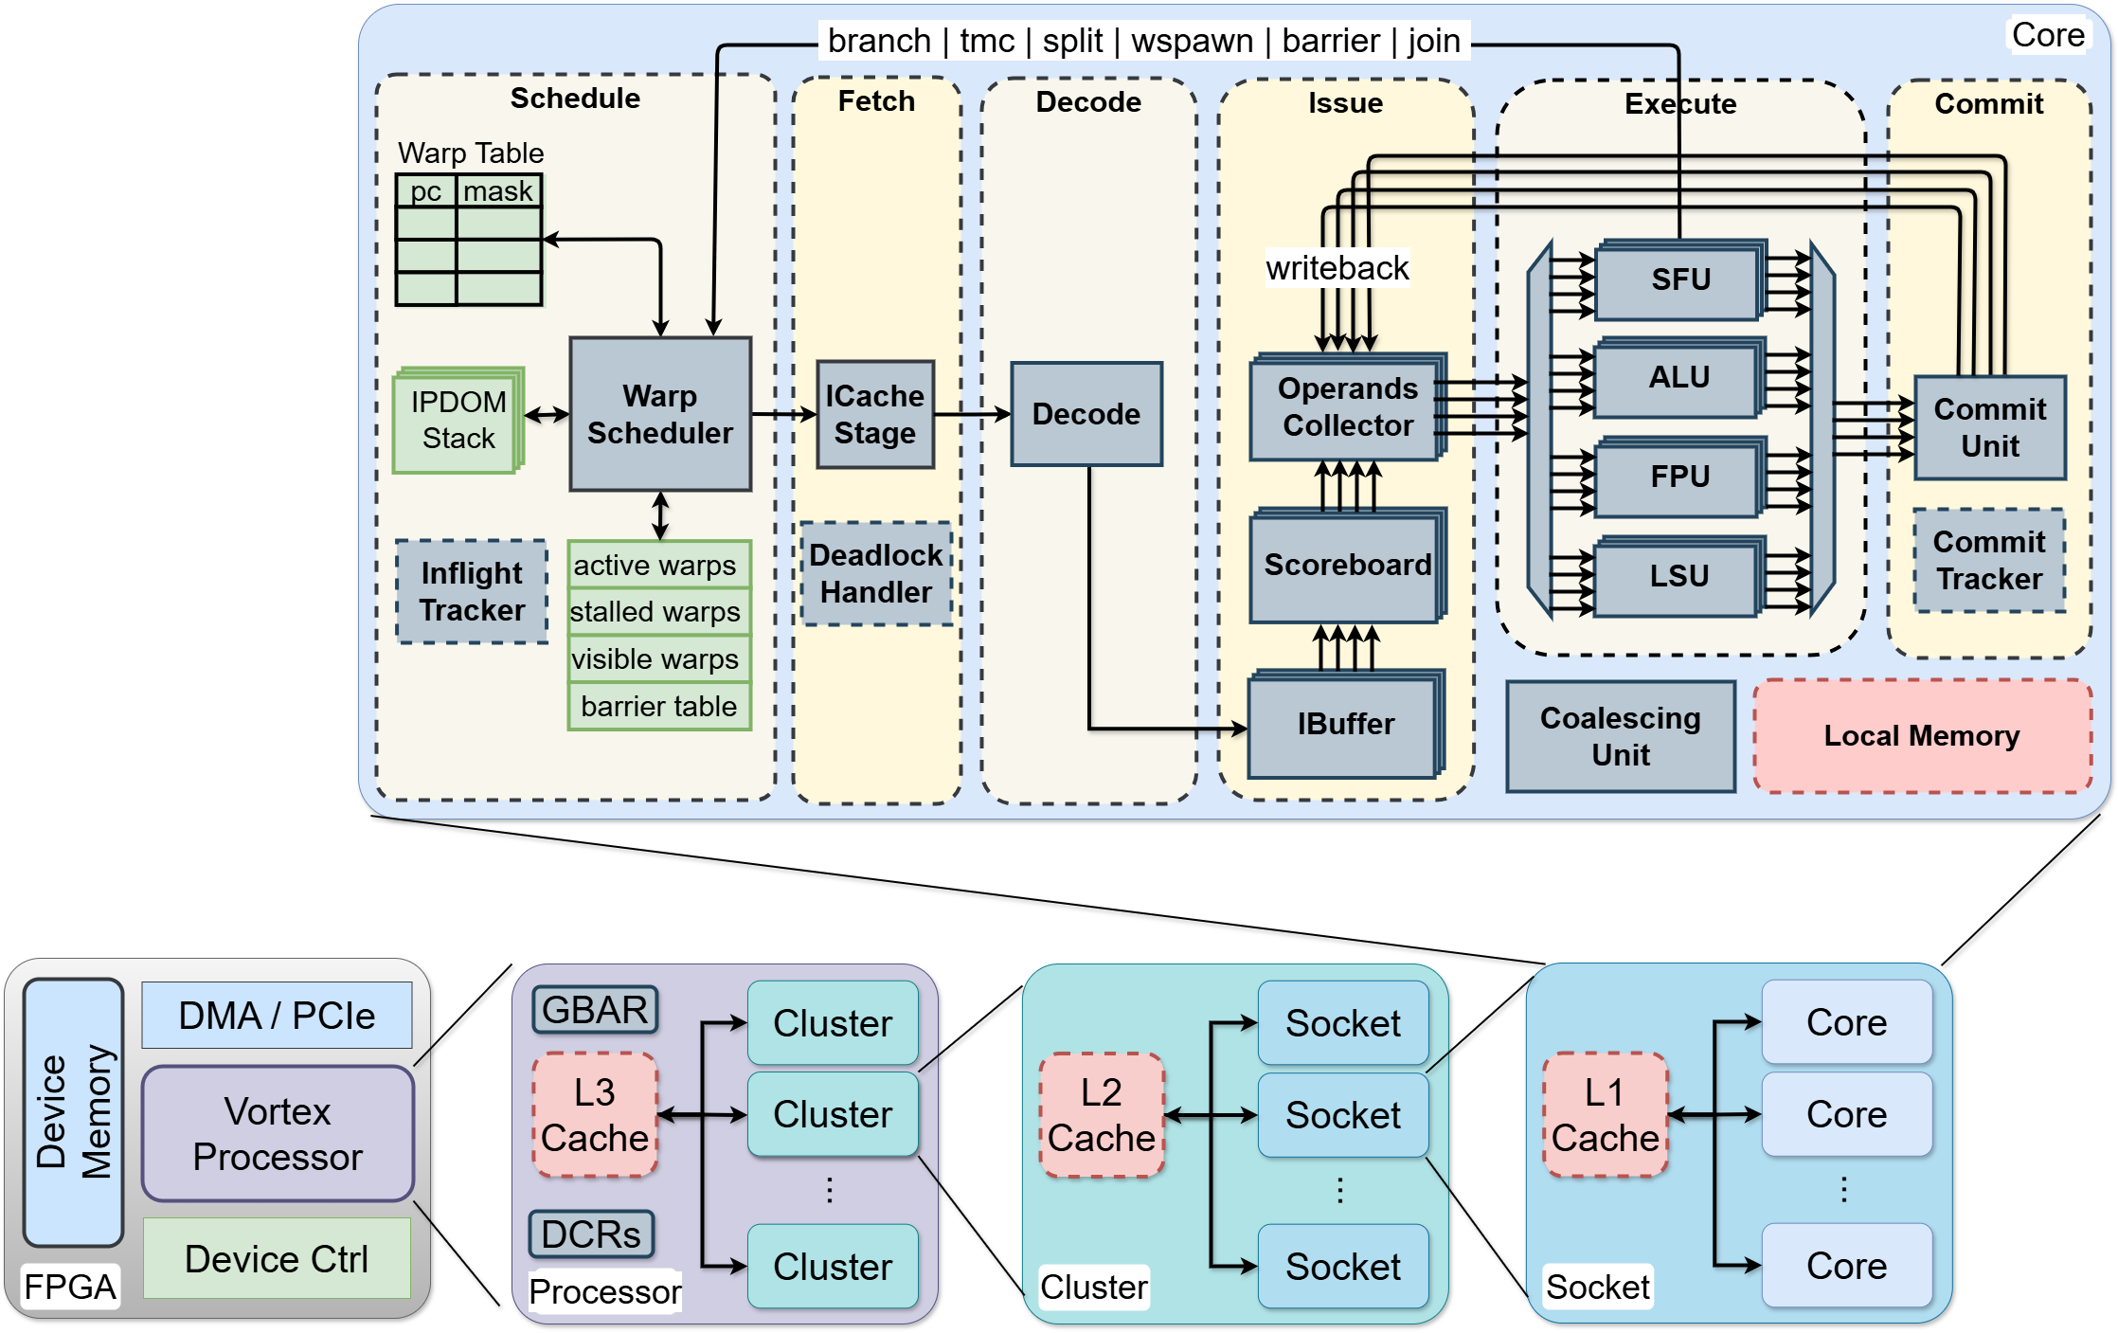
Issue Stage
Issue
Stage
the fourth one in GPGPU pipeline. ​
Plays the role of instruction flow management
keeps the whole pipeline alive through the whole process. ​
Reassures that the write back operation is done smoothly. ​

Slide 50
Issue Stage
Operands Collector Unit (OCU)
Scoreboard
I-Buffer
I-Buffer

Slide 51
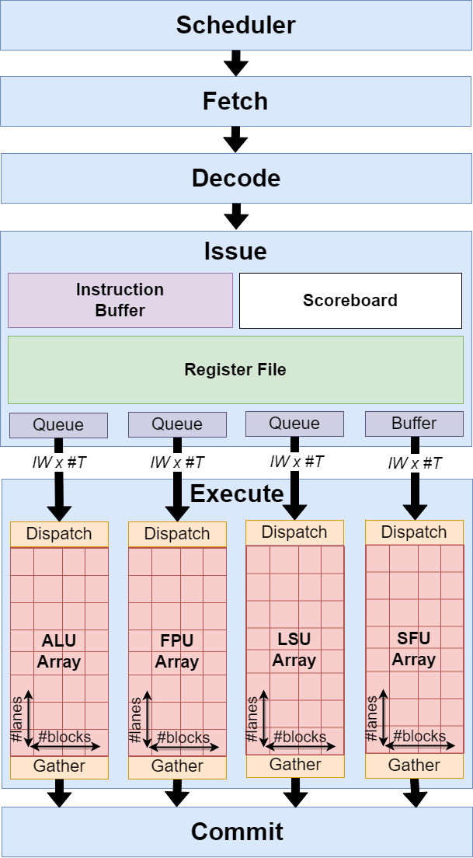
Instruction Buffer (I-Buffer)
The I-Buffer acts as a storage area for decoded instructions that are waiting to be issued to their respective execution units (ALU, FPU, LSU, or SFU).
Decoupling Pipeline Stages: It allows the Decode Stage to continue processing new instructions even if the execution Units are currently busy or stalled.
SIMT Management: Because Vortex issues instructions at the warp level, the I-Buffer holds the decoded state for a specific warp until the hardware is ready to process it.

Slide 52
Issue Stage
Operands Collector Unit (OCU)
Scoreboard
Scoreboard
I-Buffer

Slide 53
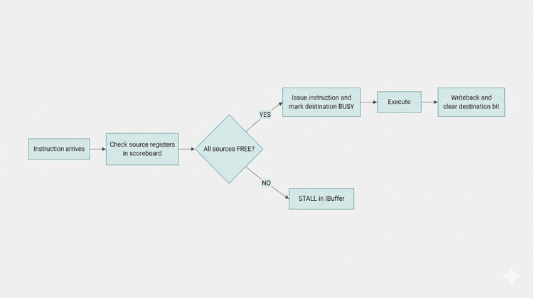
Scoreboard
Scoreboard Dependency Checking Flowchart
Notes:
The Dependency Checking Problem :
L1: MUL R5, R1, R2 ← Writes R5
L2: ADD R7, R5, R3 ← Reads R5 (depends on L1!)
Problem:
If L2 reads R5 before L1 finishes writing → Stale data → Wrong result.
This is a common RAW (Read After Write) hazard.
Solution: Track which registers are "busy" and block dependent reads.

Slide 54
Issue Stage
Operands Collector Unit (OCU)
Scoreboard
I-Buffer

Slide 55
Operand Collector (OCU)
fetching data is difficult because a single instruction must fetch source operands for all active threads in a warp. You cannot read 32 registers simultaneously from a standard register file!
To solve this, the Operand Collector Unit (OCU) acts as a smart "waiting room." It gathers the necessary data (operands) from the Register File (RF) over several cycles and only lets the instruction proceed to execution once all the data for all threads has been successfully collected.

Slide 56
Operand Collector (OCU)
Phase 1: Request Generation (Latency: 1 Cycle)
Action: identifies which registers the instruction needs
Queuing: It generates read requests for these specific registers and sends them to the "request queues" of the specific memory banks where those registers live.
Phase 2 :Bank Arbitration (Latency: Variable, 0–2+ Cycles)
The Register File is divided into "banks" to allow multiple parallel reads, but "collisions" can still happen.
Arbitration: multiple requests try to access the same bank at the same time (Bank Conflict), the hardware must decide who goes first.
Variable Latency: It is not fixed because it depends on how many conflicts occur.

Slide 57
Operand Collector (OCU)
Phase 3: Data Return (Latency: 1 Cycle per Operand)
Action: The Register File finally retrieves the value and sends it back to the OCU.
Buffering: stores these values in its internal buffer. Once every required operand for the warp is present signaling that the instruction is fully prepared for execution.

Slide 58
Execute Stage Bringing the Score to Life

Slide 59
Execution Stage
Execute
Stage
What is the Inputs to this stage ?
Because Vortex uses a SIMT model, the input is not just one value, but a set of operands for all active threads in a warp.

Slide 60
Execution Stage
Execute
Stage
Decoded Instruction (Control Signals): The opcode and decoded signals that tell the units what to do.
Warp Metadata:
Warp ID: Identifies which group of threads is currently executing.
Thread Mask: A bitmask indicating which threads within the warp are "active."
Operands (from Register File): The Operand Collector in the Issue stage fetches the source registers for all threads in the warp.
Program Counter (PC): The address of the current instruction, used specifically by the Branch units to calculate target addresses.

Slide 61
Execution Stage
Dispatch Unit
Special Function Unit
Arithmetic Logic Unit
Floating Point Unit
Load Store Unit
Gather Unit

Slide 62
Execution Stage
Dispatch Unit
Top-level dispatcher that routes instructions from the operands stage to the appropriate execution units based on the operation type.
Divide the main warp into sub warp ( packets) and for each sub warp it has number of threads equal to the number of lanes

Slide 63
Execution Stage
Dispatch Unit
Thread Handling Level
Ideal Mapping:
the number of threads is equal to or less than the number of lanes of the execution block, the mapping become 1:1 mapping, meaning that the dispatch unit passes the entire warp to the execution block to be executed all at once ( Maximum Throughput achieved in this configuration) .
Thread Serialization:
When the number of threads is greater than the number of lanes of the execution block the mapping become number of lanes : number of blocks, meaning that the dispatch unit divide the warp into packets with number of lanes to represent the number of threads that will be executed at the same time (which lead us to Multi-cycle execution).

Slide 64
Execution Stage
Dispatch Unit
Warp Handling Level
Warp Serialization:
When the Issue width which represent the number of warps can be executed are greater than the number of actual hardware blocks, we have to calculate how many batches we have which indicate the number of warps in the case of LSU & SFU blocks as they have fixed number of blocks.
( It’s not the same case for the ALU and FPU blocks as their number of blocks are configurable).
Notes:
For the Warp-level Handling: **Issue Index Mapping:**
For each execution block, the dispatch unit calculates which issue slot (warp) to route by combining the batch index and block index: `issue_idx = batch_idx * BLOCK_SIZE + block_idx`. [7](#9-6)
This means each block processes one warp from the selected batch, and batches are processed sequentially over multiple cycles when there aren't enough blocks to handle all warps simultaneously.
**Example:**
For an LSU unit with `ISSUE_WIDTH=4` and `NUM_LSU_BLOCKS=1`: [8](#9-7)
- `BATCH_COUNT = 4 / 1 = 4` batches
- Each batch contains 1 instruction
- The arbiter processes batches 0, 1, 2, 3 sequentially over 4 cycles (assuming no stalls)
- Only one warp's LSU instruction executes at a time on the single LSU block
## Notes
The batching mechanism is necessary because execution units often have fewer blocks than the issue width. For example, the default configuration has `NUM_ALU_BLOCKS = ISSUE_WIDTH` (full parallelism for ALU) but `NUM_LSU_BLOCKS = 1` (sequential processing for LSU). [9](#9-8)
Each execution block can handle instructions from different warps over time, but only one warp's instruction is processed per block per cycle. The dispatch unit's batch selection ensures fair progress across all warps waiting for the same execution unit type.

Slide 65
Execution Stage
Specific Function Unit
Handles GPGPU-specific "Vortex Extensions" and control. The "management" of the SIMT (Single Instruction, Multiple Threads) execution model. It ensures that threads and warps coordinate correctly.
1. Warp Control (SIMT Management)
The SFU executes instructions that directly modify the Warp State.
WSPAWN: This is how Vortex starts parallel execution. It (activates) additional warps to run a kernel starting at a specific program counter (PC).
TMC (Thread Mask Control): This instruction updates the active thread mask for the current warp. If a bit in the mask is 0, that thread is disabled for subsequent instructions.
Notes:
For the Warp-level Handling: **Issue Index Mapping:**
For each execution block, the dispatch unit calculates which issue slot (warp) to route by combining the batch index and block index: `issue_idx = batch_idx * BLOCK_SIZE + block_idx`. [7](#9-6)
This means each block processes one warp from the selected batch, and batches are processed sequentially over multiple cycles when there aren't enough blocks to handle all warps simultaneously.
**Example:**
For an LSU unit with `ISSUE_WIDTH=4` and `NUM_LSU_BLOCKS=1`: [8](#9-7)
- `BATCH_COUNT = 4 / 1 = 4` batches
- Each batch contains 1 instruction
- The arbiter processes batches 0, 1, 2, 3 sequentially over 4 cycles (assuming no stalls)
- Only one warp's LSU instruction executes at a time on the single LSU block
## Notes
The batching mechanism is necessary because execution units often have fewer blocks than the issue width. For example, the default configuration has `NUM_ALU_BLOCKS = ISSUE_WIDTH` (full parallelism for ALU) but `NUM_LSU_BLOCKS = 1` (sequential processing for LSU). [9](#9-8)
Each execution block can handle instructions from different warps over time, but only one warp's instruction is processed per block per cycle. The dispatch unit's batch selection ensures fair progress across all warps waiting for the same execution unit type.

Slide 66
Execution Stage
Specific Function Unit
Handles GPGPU-specific "Vortex Extensions" and control. The "management" of the SIMT (Single Instruction, Multiple Threads) execution model. It ensures that threads and warps coordinate correctly.
2. Control Flow Divergence (Divergence Management)
When a warp hits an if/else statement where some threads take the "if" path and others take the "else" path, the SFU manages the IPDOM (Immediate Post-Dominator) Stack.
SPLIT: Pushes the current thread mask and the return address onto a hardware stack to handle the divergent path.
JOIN: Pops the stack to restore the original thread mask once the divergent paths reconverge.
Notes:
For the Warp-level Handling: **Issue Index Mapping:**
For each execution block, the dispatch unit calculates which issue slot (warp) to route by combining the batch index and block index: `issue_idx = batch_idx * BLOCK_SIZE + block_idx`. [7](#9-6)
This means each block processes one warp from the selected batch, and batches are processed sequentially over multiple cycles when there aren't enough blocks to handle all warps simultaneously.
**Example:**
For an LSU unit with `ISSUE_WIDTH=4` and `NUM_LSU_BLOCKS=1`: [8](#9-7)
- `BATCH_COUNT = 4 / 1 = 4` batches
- Each batch contains 1 instruction
- The arbiter processes batches 0, 1, 2, 3 sequentially over 4 cycles (assuming no stalls)
- Only one warp's LSU instruction executes at a time on the single LSU block
## Notes
The batching mechanism is necessary because execution units often have fewer blocks than the issue width. For example, the default configuration has `NUM_ALU_BLOCKS = ISSUE_WIDTH` (full parallelism for ALU) but `NUM_LSU_BLOCKS = 1` (sequential processing for LSU). [9](#9-8)
Each execution block can handle instructions from different warps over time, but only one warp's instruction is processed per block per cycle. The dispatch unit's batch selection ensures fair progress across all warps waiting for the same execution unit type.

Slide 67
Execution Stage
Specific Function Unit
Handles GPGPU-specific "Vortex Extensions" and control. The "management" of the SIMT (Single Instruction, Multiple Threads) execution model. It ensures that threads and warps coordinate correctly.
3. Warp Synchronization (Barriers)
The SFU manages the BAR instruction.
It tracks how many warps have reached a specific "Barrier ID“ and sends a signal to the Warp Scheduler to stall these warps until the global or local "count" condition is met, ensuring all warps are synchronized before continuing.
4. CSR Operations
handles reading and writing to Control and Status Registers (CSRs). These registers store processor metadata, performance counters, and configuration settings that the software needs to access.
Notes:
For the Warp-level Handling: **Issue Index Mapping:**
For each execution block, the dispatch unit calculates which issue slot (warp) to route by combining the batch index and block index: `issue_idx = batch_idx * BLOCK_SIZE + block_idx`. [7](#9-6)
This means each block processes one warp from the selected batch, and batches are processed sequentially over multiple cycles when there aren't enough blocks to handle all warps simultaneously.
**Example:**
For an LSU unit with `ISSUE_WIDTH=4` and `NUM_LSU_BLOCKS=1`: [8](#9-7)
- `BATCH_COUNT = 4 / 1 = 4` batches
- Each batch contains 1 instruction
- The arbiter processes batches 0, 1, 2, 3 sequentially over 4 cycles (assuming no stalls)
- Only one warp's LSU instruction executes at a time on the single LSU block
## Notes
The batching mechanism is necessary because execution units often have fewer blocks than the issue width. For example, the default configuration has `NUM_ALU_BLOCKS = ISSUE_WIDTH` (full parallelism for ALU) but `NUM_LSU_BLOCKS = 1` (sequential processing for LSU). [9](#9-8)
Each execution block can handle instructions from different warps over time, but only one warp's instruction is processed per block per cycle. The dispatch unit's batch selection ensures fair progress across all warps waiting for the same execution unit type.

Slide 68
Execution Stage
Arithmetic Logic Unit
Handles all standard Integer processing and logical decisions. It is the "workhorse" for general computing.
1. Arithmetic Operations
2. Logical Operations
3. Shift Operations
4. Comparisons
Notes:
For the Warp-level Handling: **Issue Index Mapping:**
For each execution block, the dispatch unit calculates which issue slot (warp) to route by combining the batch index and block index: `issue_idx = batch_idx * BLOCK_SIZE + block_idx`. [7](#9-6)
This means each block processes one warp from the selected batch, and batches are processed sequentially over multiple cycles when there aren't enough blocks to handle all warps simultaneously.
**Example:**
For an LSU unit with `ISSUE_WIDTH=4` and `NUM_LSU_BLOCKS=1`: [8](#9-7)
- `BATCH_COUNT = 4 / 1 = 4` batches
- Each batch contains 1 instruction
- The arbiter processes batches 0, 1, 2, 3 sequentially over 4 cycles (assuming no stalls)
- Only one warp's LSU instruction executes at a time on the single LSU block
## Notes
The batching mechanism is necessary because execution units often have fewer blocks than the issue width. For example, the default configuration has `NUM_ALU_BLOCKS = ISSUE_WIDTH` (full parallelism for ALU) but `NUM_LSU_BLOCKS = 1` (sequential processing for LSU). [9](#9-8)
Each execution block can handle instructions from different warps over time, but only one warp's instruction is processed per block per cycle. The dispatch unit's batch selection ensures fair progress across all warps waiting for the same execution unit type.

Slide 69
Execution Stage
Load Store Unit
The interface between the processor and the Memory System (L1 Data Cache). It is the only unit that can read/write to memory.
Loads: Reading data from memory into registers
Stores: Writing data from registers to memory
Atomics: Handles Atomic Memory Operations (AMOADD, AMOSWAP) used for synchronization between threads.
Address Calculation: It calculates the effective memory address (Base Address + Offset) for every thread in the warp.
Notes:
For the Warp-level Handling: **Issue Index Mapping:**
For each execution block, the dispatch unit calculates which issue slot (warp) to route by combining the batch index and block index: `issue_idx = batch_idx * BLOCK_SIZE + block_idx`. [7](#9-6)
This means each block processes one warp from the selected batch, and batches are processed sequentially over multiple cycles when there aren't enough blocks to handle all warps simultaneously.
**Example:**
For an LSU unit with `ISSUE_WIDTH=4` and `NUM_LSU_BLOCKS=1`: [8](#9-7)
- `BATCH_COUNT = 4 / 1 = 4` batches
- Each batch contains 1 instruction
- The arbiter processes batches 0, 1, 2, 3 sequentially over 4 cycles (assuming no stalls)
- Only one warp's LSU instruction executes at a time on the single LSU block
## Notes
The batching mechanism is necessary because execution units often have fewer blocks than the issue width. For example, the default configuration has `NUM_ALU_BLOCKS = ISSUE_WIDTH` (full parallelism for ALU) but `NUM_LSU_BLOCKS = 1` (sequential processing for LSU). [9](#9-8)
Each execution block can handle instructions from different warps over time, but only one warp's instruction is processed per block per cycle. The dispatch unit's batch selection ensures fair progress across all warps waiting for the same execution unit type.

Slide 70
Execution Stage
Floating Point Unit
This design optimizes for Area Efficiency by balancing heavily used units against large, infrequently used ones.
Arithmetic: Addition (FADD), Subtraction, Multiplication.
Fused Operations: FMA (Fused Multiply-Add), which is critical for matrix math.
Comparisons: FEQ, FLT, FLE (setting flags based on float values).
Type Conversions: Converting between Signed/Unsigned Integers and Floating Point.
Notes:
For the Warp-level Handling: **Issue Index Mapping:**
For each execution block, the dispatch unit calculates which issue slot (warp) to route by combining the batch index and block index: `issue_idx = batch_idx * BLOCK_SIZE + block_idx`. [7](#9-6)
This means each block processes one warp from the selected batch, and batches are processed sequentially over multiple cycles when there aren't enough blocks to handle all warps simultaneously.
**Example:**
For an LSU unit with `ISSUE_WIDTH=4` and `NUM_LSU_BLOCKS=1`: [8](#9-7)
- `BATCH_COUNT = 4 / 1 = 4` batches
- Each batch contains 1 instruction
- The arbiter processes batches 0, 1, 2, 3 sequentially over 4 cycles (assuming no stalls)
- Only one warp's LSU instruction executes at a time on the single LSU block
## Notes
The batching mechanism is necessary because execution units often have fewer blocks than the issue width. For example, the default configuration has `NUM_ALU_BLOCKS = ISSUE_WIDTH` (full parallelism for ALU) but `NUM_LSU_BLOCKS = 1` (sequential processing for LSU). [9](#9-8)
Each execution block can handle instructions from different warps over time, but only one warp's instruction is processed per block per cycle. The dispatch unit's batch selection ensures fair progress across all warps waiting for the same execution unit type.

Slide 71
Execution Stage
Floating Point Unit
This design optimizes for Area Efficiency by balancing heavily used units against large, infrequently used ones.
A. Fully Parallel Units (1:1 Mapping)
B. Serialized Units (Shared Resources)
C. NCP Blocks (Non-Computational Path / Control)
Notes:
For the Warp-level Handling: **Issue Index Mapping:**
For each execution block, the dispatch unit calculates which issue slot (warp) to route by combining the batch index and block index: `issue_idx = batch_idx * BLOCK_SIZE + block_idx`. [7](#9-6)
This means each block processes one warp from the selected batch, and batches are processed sequentially over multiple cycles when there aren't enough blocks to handle all warps simultaneously.
**Example:**
For an LSU unit with `ISSUE_WIDTH=4` and `NUM_LSU_BLOCKS=1`: [8](#9-7)
- `BATCH_COUNT = 4 / 1 = 4` batches
- Each batch contains 1 instruction
- The arbiter processes batches 0, 1, 2, 3 sequentially over 4 cycles (assuming no stalls)
- Only one warp's LSU instruction executes at a time on the single LSU block
## Notes
The batching mechanism is necessary because execution units often have fewer blocks than the issue width. For example, the default configuration has `NUM_ALU_BLOCKS = ISSUE_WIDTH` (full parallelism for ALU) but `NUM_LSU_BLOCKS = 1` (sequential processing for LSU). [9](#9-8)
Each execution block can handle instructions from different warps over time, but only one warp's instruction is processed per block per cycle. The dispatch unit's batch selection ensures fair progress across all warps waiting for the same execution unit type.

Slide 72
Execution Stage
Gather Unit
The inverse of the Dispatch Unit. It acts as a collector that merges results from the parallel hardware lanes back into a unified instruction packet.

Slide 73
Commit Stage The Final touch

Slide 74
Commit Stage
Commit
Stage
Two Main Responsibilities
Register Update (Writeback) : Ensure that only the threads that were active during the instruction update their registers (inactive threads leave their registers untouched).
Hazard Resolution (Scoreboard Clearing): "unlocks" the destination register in the Scoreboard, allowing waiting instructions that need this data to finally proceed.

Slide 75
Commit Stage
Commit
Stage
Inputs to the Commit Stage
Execution Results: The calculated data coming from execution unit
Destination Index (rd): The address of the register where the result should be stored.
Warp Context : Warp ID , Thread Mask and PC

Slide 76
Commit Stage
Commit
Stage
Outputs from the Commit Stage
Register Write Signals:
Destination: To the Register File.
Data: The actual 32 values to be written.
Write Enable: Controls which specific bytes/threads are written.
Scoreboard Release Signal: A feedback signal sent back to the Issue Stage saying, "Warp X has finished writing to Register Y. Clear the busy bit."

Slide 77
Commit Stage

Slide 78
Memory Architecture
The Parallel Memory Execution Unit

Slide 79
Memory Architecture
Outlines:
Introduction
Memory Hierarchy
LSU Slice Architecture
Scheduling and Coalescing

Slide 80
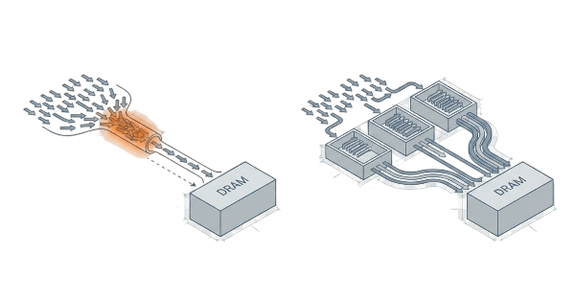
Why are We interested in memory

Slide 81
Why are We interested in memory
Problem:
Hundreds of threads issuing simultaneous requests create a bottleneck at the main memory interface.

Slide 82
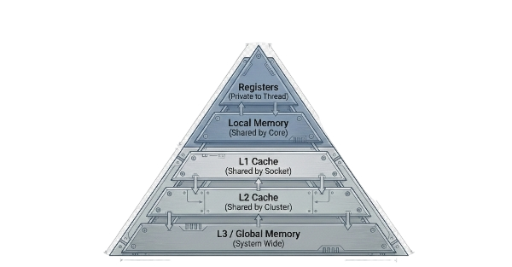
Memory Hierarchy

Slide 83



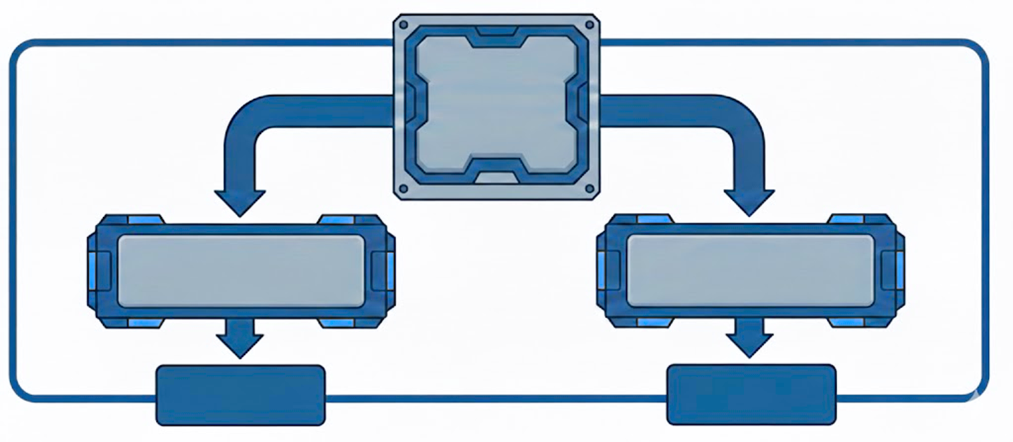
L1
Cache
I-Cache
D-Cache
Fetch Unit
LSU

Slide 84
L1 Data Cache
What is the D-Cache?
Role: Fastest storage, closest to the core.
Capacity: 32-64 KB.
Speed: 3–10 cycles
Management: Automatic (Hardware-controlled transparency).
Bandwidth: Extremely high (>100 GB/s per core).

Slide 85
L1 Data Cache
How does it work?
The Flow: Request → Check L1 → Hit (Fast) or Miss (Fetch from L2).
Scope: within the core.
The Cache Line:
Memory is fetched in chunks (e.g., 128 bytes), not single bytes.

Slide 86
L1 Instruction Cache
Distinct Roles
The Job: Stores machine code (opcodes), not variables.
The Goal: Feed the Instruction Fetch Unit constantly to prevent pipeline stalls.
Key Traits: Read-Only (Safety), Private (Per Core), Low Latency (~5 cycles).

Slide 87
L2 Cache
Unified Storage for Multi-Core Efficiency
The Strategic Role
The Bridge: Sits between hyper-fast L1 and sluggish DRAM.
The Hub: Unlike L1 (Private), L2 is Shared across multiple cores.
The Format: Unified stores both Instructions and Data in one place.
The Speed/Size Trade-off
Capacity: 512 KB – 6 MB (Up to 100x larger than L1).
Latency: ~30 cycles (Slower than L1, but 13x faster than DRAM).
Goal: Filter out 70-90% of traffic before it hits main memory.

Slide 88
DRAM
Device Memory “Infinite Space, Expensive Access“
The Scale
The Role: The ultimate storage for all GPU data (Gigabytes to Tens of GBs).
The Trade-off:
Capacity: 100,000x larger than L2.
Latency: 400–800 cycles. (The processor spends an eternity waiting).

Slide 89
Shared Memory
Manual Control for Deterministic Speed: The Programmer’s Scratchpad
Control vs. Chaos
The Definition: On-chip, high-speed memory managed manually by you (the code), not the hardware.
The Stats:
Latency: Deterministic 1–2 cycles (Faster than L1).
Scope: Shared strictly within a Thread Block.

Slide 90



Cache Bank Architecture

Slide 91

Why Multi-Bank Cache Design?
The Problem
Single cache port severely limits parallelism in GPGPU architectures where thousands of threads require simultaneous memory access. With a monolithic cache design:
▸Only one request per cycle can be serviced
▸Warps with 32 threads experience 32-way serialization
▸Massive performance bottleneck limits scalability
▸Thread-level parallelism cannot be exploited

Slide 92







Why Multi-Bank Cache Design?
Single Cache vs. Multi-Bank Comparison
Single Cache Design
Multi-Bank Design (4 Banks)
CACHE
B0
B1
B2
B3
1
req/cycle
32×
4×
parallel
serialized
throughput
4
Serial Access
Parallel Access
Example: 4-bank design achieves 4× bandwidth
Single Cache
⟶
4-Bank Cache
3.2 GB/s
12.8 GB/s

Slide 93



Banking Architecture Overview
Key Features
Each bank is a complete, independent cache
All banks operate simultaneously in parallel
Four banks: Bank 0, Bank 1, Bank 2, Bank 3
This parallel operation is the key to performance
Each bank contains:
Bank 0
Bank 1
Bank 2
Bank 3
Tag Array
Tag Array
Tag Array
Tag Array
Data Array
Data Array
Data Array
Data Array
MSHR
MSHR
MSHR
MSHR

Slide 94
Banking Architecture Overview
Each bank contains:
Bank
Request Queue & Arbiter
MSHR
(Miss Status Handling Register)
Tag Array
Data Array
Replecement Logic

Slide 95
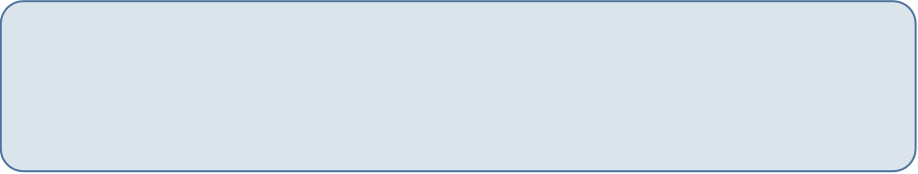
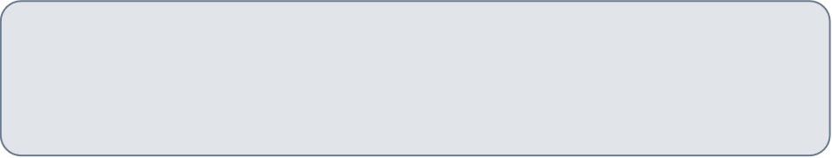

MSHR
Complete Hit Path Flow
Miss Path Flow
Request Arrives
Request → Tag Lookup
Miss Detection
Core issues request to cache bank
Stage 0: Tag Lookup
MSHR Allocation
Hit Detection
Memory Request
One way matches, way selected
Next level Access
Stage 1: Data Read
Fill Arrival
Access data array at selected way
Response Generation
Replay Initiated
Format response with data and status
Data Written
Send to Requester
Now Hits → Response
Response routed back to core

Slide 96
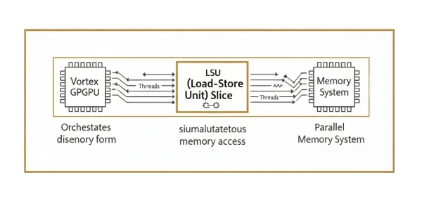
What is an LSU Slice?
Core Concept

Slide 97
What is an LSU Slice?
Core Concept
The LSU (Load-Store Unit) Slice is a fundamental execution unit that serves as a parallel memory access processor in the Vortex GPGPU architecture.
When multiple threads need to read from or write to memory simultaneously, the slice orchestrates these operations, ensuring each thread accesses the correct location with the proper data format.
Architectural Role
The slice acts as the critical bridge between the parallel compute pipeline and the memory system, translating high-level memory operations into low-level memory transactions.

Slide 98
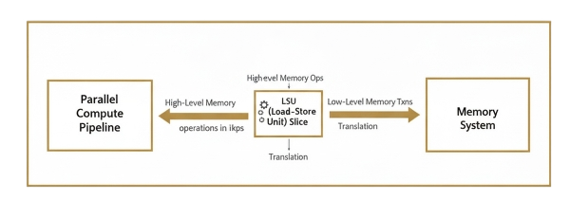
What is an LSU Slice?
Architectural Role

Slide 99
LSU Slice Execution Responsibilities
Address Generation
Memory Type Classification
Data Format Translation
Parallel Lane Management

Slide 100
Address Generation Mechanism
The slice takes base addresses and offsets from instructions and computes the actual memory locations where data should be read or written.

Slide 101
Address Generation Mechanism
Parallel Address Calculation for Multiple Threads
Address Generation Formula
Effective Address = Base + Offset

Slide 102
Memory Type Classification
System Memory
Local Memory
Global Address Space
Shared & Private
different memory types access while maintaining correctness and performance.

Slide 103
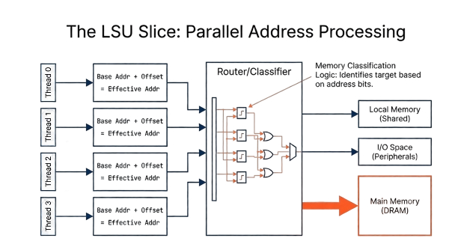

Slide 104
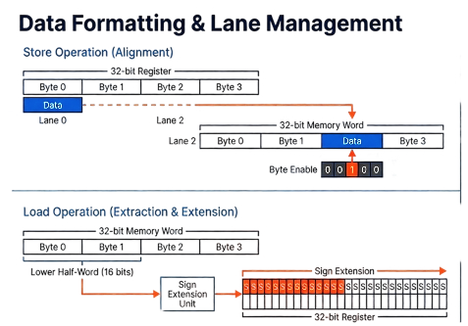

Slide 105
Memory Coalescer and Memory Scheduler

Slide 106
Memory Coalescer
The Problem?
Independent thread request cause redundant accesses and waste bandwidth.
Consider a Scenario where 4 Threads Access Consecutive Words : Thread 0: Request word at 0x1000 → 32-bit transaction. Thread 1: Request word at 0x1004 → 32-bit transaction. Thread 2: Request word at 0x1008 → 32-bit transaction. Thread 3: Request word at 0x100C → 32-bit transaction.
4 Separate Transactions: Total: 128 bits transferred, 4× overhead.

Slide 107
Coalescer saves the day
Coalescing Solves it!
Coalescer detects requests targeting near cashe locations and merges them.
Same Scenario but after coalescing :
Coalesced Request: 128 bits (4 words) at 0x1000. Byte-enables: ‘b1111 (all threads are active).
1 Combined Transaction: Total: 128 bits transferred, 1× overhead.

Slide 108
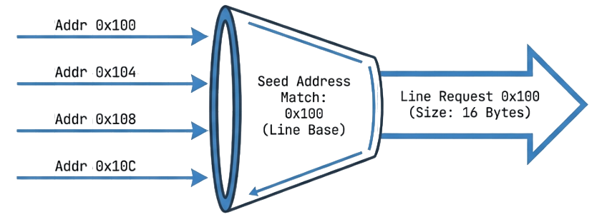
Performance Optimization
Performance Impact:
Coalescer significantly reduces memory bandwidth consumption and improves performance.
• 4× fewer transactions.
• 4× less memory controller load.
• Better cache line utilization.

Slide 109
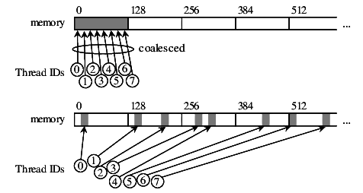
Operation
How It Works :
The coalescer operates by:
Collects requests from multiple LSU lanes.
Groups requests targeting the same cache line.
Combines matching requests into fewer, larger transactions.
Reconstructs per-thread responses using an index buffer.

Slide 110

Merging Logic
Combining Byte-Enables, Preserving IDs, and Packing Data
The core merging logic used inside the memory coalescer follows these steps:
OR Operation :
Byte-enable masks are OR ’ed to form one merged access mask.
Identity Preservation :
Lane/ID mapping is saved to reconstruct per-thread responses.
Data Combination :
Store data is packed by byte offset (loads only need response splitting).

Slide 111
Byte Level Merging With Enable Masks :
Preserving Byte-Level Precision:
Byte-enable masks track and return the exact bytes each thread needs within a shared cache line.
Example: Partial word accesses.
Cashe line: 128 bits (16 bytes) at 0x10000
B0 | B1 | B2 | B3 | B4 | B5 | B6 | B7
Thread 0:
Bytes 0-2
Enable :
’b00000111
Thread 1:
Bytes 3-4
Enable :
’b00011000
Thread 2:
Bytes 5-6
Enable :
’b01100000
Combined Enable ’b01111111 (Bytes 0-6)
All 3 requests are combined into 1 transaction with precise byte tracking

Slide 112
Multi-Batch Handling Flow
What happens when not all the requests can merge ?
Not necessarily that all incoming requests target nearby addresses:
Initial Request Pool:
Multiple memory requests arrive from LSU slice targeting different cache lines.
Req A-D : Line 0x1000
Req E-G : Line 0x2000
Batch Information:
Coalescer groups requests by cache line, creates multiple batches.
Batch 1: Req A-D
Batch 2: Req E-G
Sequential Processing:
Batches sent sequentially to memory system with tracking.
Send Batch 1
Send Batch 2

Slide 113
Memory Scheduling System
Post-Coalescing Optimization:
After coalescing, multiple memory transactions still arrive in parallel and must be organized to avoid stalls and congestion.
What is the need for the Scheduling ?
Scheduling is needed to manage competing requests for limited memory ports, preventing queue buildup and backpressure, and avoiding stalls and poor throughput.
Coalescer
Scheduler
Memory

Slide 114
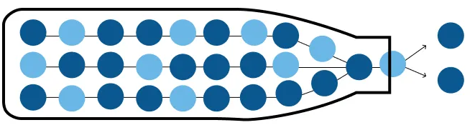
The Need for Scheduling
Why is it a problem ?
Consider the case where the requests arrive as a burst:
Req A 🡪 Line 0x1000 Req B 🡪 Line 0x2000 Req C 🡪 Line 0x3000 Req D 🡪 Line 0x1000
Without scheduling :
Requests may serialize this will cause pipeline stalls as requests will wait even when resources exist.

Slide 115
Scheduling Solution
Scheduling Solves It! Scheduler queues requests and dispatches them based on resource availability.
Request Queueing:
Buffers pending requests to avoid stalls.
Issue Selection:
Selects next ready transaction to issue.
Channel Distribution:
Balances requests across memory channels.

Slide 116
Operation
Multi-Channel Distribution:
Distributes requests across parallel channels and batches excess requests to maximize throughput.
4-Channel Memory System
Coalesced Requests
8 requests
Req 0
Req 1
Req 2
Req 3
Req 4
Req 5
Req 6
Req 7
Channel 0
Channel 1
Channel 2
Channel 3
Active
Active
Active
Active
Cycle 0: Req 0
Cycle 0: Req 1
Cycle 0: Req 2
Cycle 0: Req 3
Cycle 1: Req 4
Cycle 1: Req 5
Cycle 1: Req 6
Cycle 1: Req 7

Slide 117

Performance Optimization
Performance Impact:
Scheduler improves memory throughput and reduces pipeline blocking.
Higher memory-level parallelism.
Reduced queue stalls.
Better channel utilization.
Improved overall throughput.

Slide 118
The Index Buffer Mechanism
Index Buffer:
Purpose:
Stores metadata to reconstruct each in-flight memory request.
What it Tracks:
Thread/format info + byte offsets/masks + completion status.
Why Needed?
Handles long latency, out-of-order returns, and multi-threaded requests.
Index buffer Operation:
1
Request Issue
2
Response Arrival
3
Data Response

Slide 119
Tag Management System
Unique Tracking Numbers for Each Request:
Each request is assigned a unique tag that identifies it and ensures correct response routing.
Purpose:
Assigns a unique tag per request for correct response routing.
Tag Contents:
Request ID • Thread mask • Channel • Sequence
Why It Matters:
Supports out-of-order returns and correct per-thread delivery.
Tag Flow:
Assign 🡪 Send 🡪 Return with tag 🡪 Route back

Slide 120
Project Master Plan

Slide 121
Project Master Plan
Phase I
Preparation & Infrastructure
Phase II
Synthesis & DFT
Phase III
Synthesis & DFT
Phase IV
Synthesis & DFT
Phase II
Post-Synthesis Verification
Phase III
Post-Synthesis Verification
Phase IV
Synthesis & DFT

Slide 122
ASIC Design Master Plan
Two Parallel Tracks
ASIC Design Master Plan
Verification Master Plan

Slide 123
ASIC Design Master Plan
Phase I: Preparation & Infrastructure
Study architecture
Setup project management (GitHub) and install tools.
Build simulation environment and verify functional correctness.
Phase II: Synthesis & DFT
Adapt full RTL for ASIC flow (convert from FPGA code to ASIC).
Generate gate-level netlists and clean timing reports for the Core and Full Chip.

Slide 124
ASIC Design Master Plan
Phase III: Physical Design (Backend)
Floorplanning (macro placement, power grid).
Place & Route (Standard cells, Clock Tree Synthesis, Routing).
Phase IV: Optimization & Signoff
Architectural Optimizations (Opt1 & Opt2) to improve PPA (Power, Performance, Area).
Final Signoff (Static Timing Analysis, DRC/LVS, Power Analysis) and Documentation.

Slide 125
Semester (1) Status Report

Slide 126
Initial Synthesis

Slide 127
VX_fpu_unit RTL-to-ASIC Synthesis

Slide 128
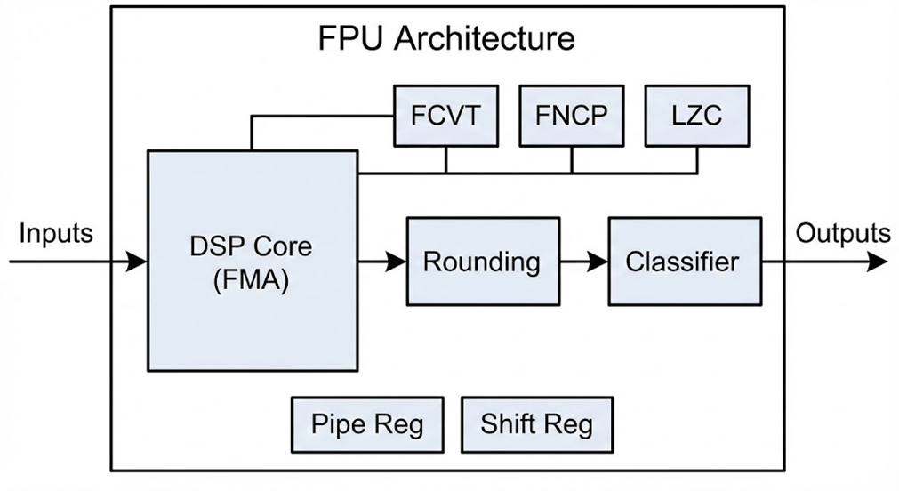
Design Overview
VX_fpu_unit is a single-precision floating-point execution unit for the Vortex GPU, implemented in generic System Verilog with no vendor-specific IP.
5–8 stage pipelined architecture targeting 10 ns clock period (100 MHz) at TSMC 7-nm, 0.75 V, 25°C.

Slide 129
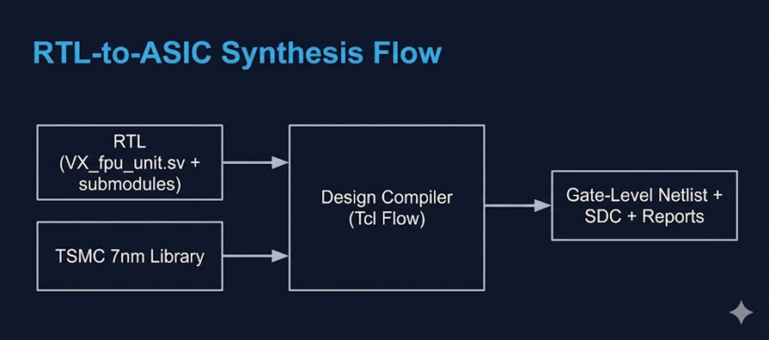
RTL-to-ASIC Synthesis Flow
Automated Tcl flow in Synopsys Design Compiler (T-2022.03-SP2) to map technology-agnostic RTL to TSMC 7-nm standard cells.
Configure TSMC 7-nm libraries and analyze all FPU RTL files.
Elaborate design, apply 10 ns clock constraint, and run with clock gating.
Generate gate-level netlist, SDC file, and timing/area/power reports.

Slide 130
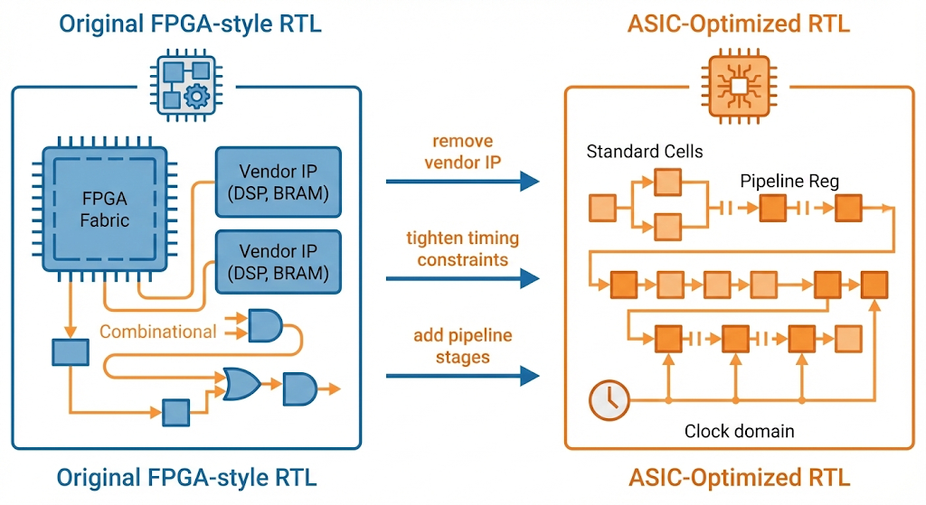
ASIC-Friendly Changes
we removed all vendor-specific primitives and FPGA IP blocks – everything is now generic System Verilog.

Slide 131
ASIC-Friendly Changes
Removed FPGA‑specific DSP usage – Replaced vendor‑style DSP slice assumptions with pure SystemVerilog multipliers/adders that map to standard cells.
Ex: vx_fpu_dsp_core.sv – rewrote the FMA datapath using plain * and + operators instead of inferred FPGA DSP blocks, with technology‑independent parameters
Re‑pipelined for 7‑nm timing – Broke long combinational paths and redistributed registers so the FMA meets 10 ns in an ASIC clock tree, not just in FPGA fabric.
Ex: vx_fpu_dsp_core.sv and vx_fpu_pipeline.sv – inserted extra pipeline registers around the multiplier and adder stages to break the longest combinational paths
Clean clock/reset scheme – Unified a single clock domain, converted most async resets to synchronous, and simplified enables so STA and synthesis are stable.
Ex : vx_fpu_regs.sv – standardized all flip‑flops to one always_ff @(posedge clk) with synchronous reset and simple enables, removing scattered async resets.”

Slide 132
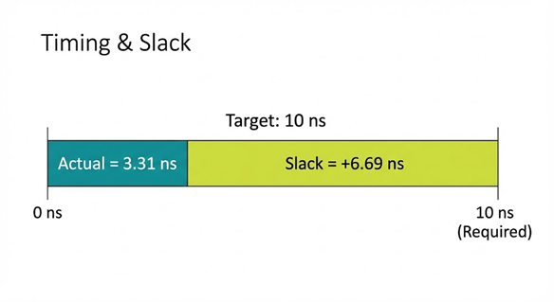
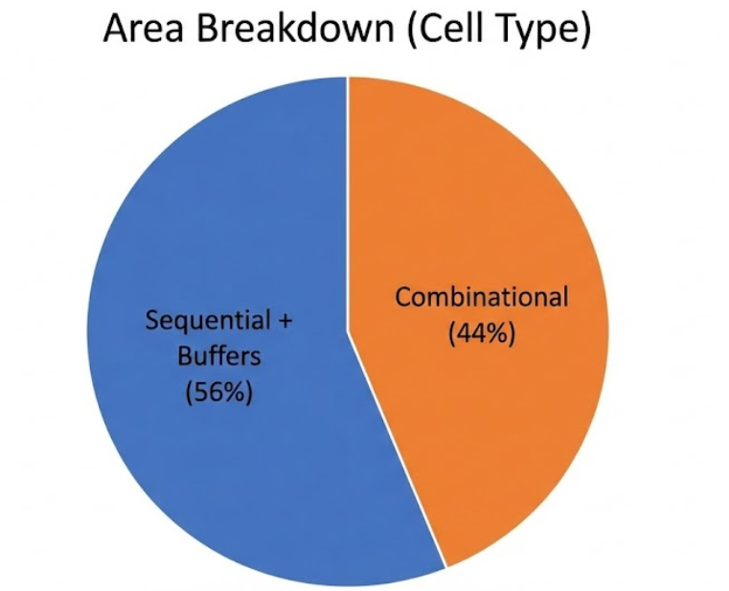
Synthesis Results
Timing
Target clock: 10 ns (100 MHz) with worst-case
setup slack of +6.69 ns.
Internal FF-to-FF slack: +8.80 ns → >67% frequency margin.
Area
Total area: 385.75 µm² (~0.04 mm²) at TSMC 7-nm.
2,388 cells: 1,682 combinational, 577 sequential, 252 buffers/inverters.

Slide 133
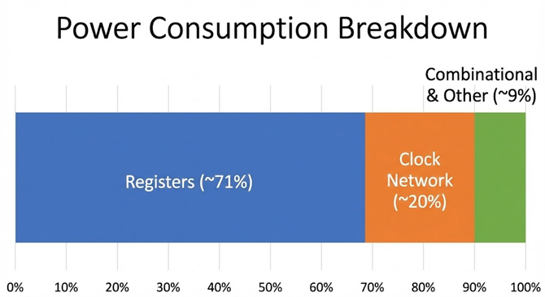
Synthesis Results
Power
Total dynamic power: 59.71 µW at 0.75 V, 25°C, 100 MHz; leakage < 0.3%.
Power dominated by pipeline registers (~71%) and clock network (~20%).

Slide 134
Design Quality & Insights
Zero critical errors, 100% module resolution, no black-box cells.
Only non-critical warnings (optional debug and configuration-dependent signals).
Pipeline efficiency: 5–8 stage pipeline achieves timing closure with large slack at 100 MHz.
Technology independence: pure SystemVerilog RTL retargeted from FPGA-style design to 7-nm ASIC by library substitution.

Slide 135
SFU Unit RTL-to-ASIC Synthesis

Slide 136
RTL-to-ASIC Synthesis Flow
Successfully converted macros that have function to modules such as the popcount.
Popcount purpose is to count the number of bits set to 1 in an input bit-vector of length

Slide 137
Synthesis Results
Timing
Target clock: 100 ns (10 MHz) with worst-case
setup slack of +99.15 ns.
Area
Total area: 1239.7 µm² at TSMC 7-nm.
6586 cells: 4537 combinational, 1907 sequential, 1055 buffers/inverters.

Slide 138
LSU Unit RTL-to-ASIC Synthesis

Slide 139
Synthesis Results
Timing
Target clock: 50 ns (20 MHz) with worst-case
setup slack of +48.56 ns.
Area
Total area: 126,397.6 µm² at TSMC 130-nm.

Slide 140
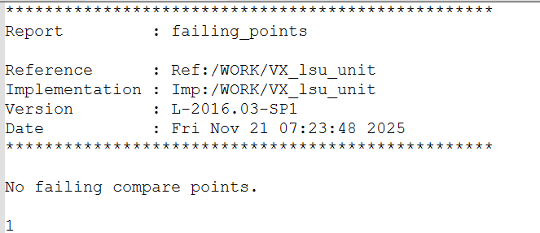
Formality Results
Failing Points:

Slide 141
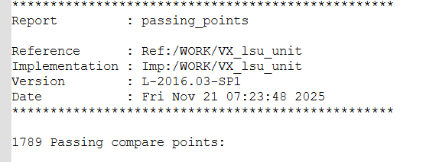
Formality Results
Passing Points:

Slide 142
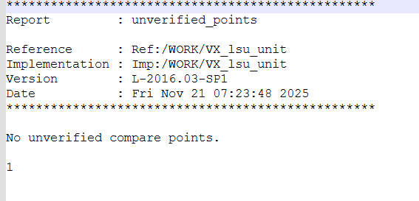
Formality Results
Unverified Points:

Slide 143
ASIC Roadmap

Slide 144
Next Semester Roadmap (To-Do)
Milestone 1: Complete Full-Chip Synthesis
GOAL:
• Ensure the entire Vortex architecture (not just the core) is synthesizable
Action:
• Modify the remaining RTL blocks to be synthesis-friendly.
Finalize SDC constraints (clock speeds, I/O delays) and generate the full gate-level netlist.
Milestone 2: Baseline Physical Implementation
Action:
Floorplanning: Define the chip size, place pins, and arrange memory macros.
Place & Route: Run automated placement of standard cells, build the clock tree (CTS), and route the wires.
GOAL:
• Move the synthesized netlist into a physical layout.

Slide 145
Next Semester Roadmap (To-Do)
Milestone 3: Microarchitectural Optimizations
GOAL:
• Improve the design based on your analysis.
Action:
Implement specific RTL changes (e.g., scheduler or cache logic) to improve performance or area.
Compare the PPA (Power, Performance, Area) of your optimized design against the baseline you created in Milestone 2.
Milestone 4: Signoff & Documentation
Action:
Run Static Timing Analysis (STA) to ensure no setup/hold violations exist at your target frequency.
Complete the final report/paper summarizing the flow and PPA results.
GOAL:
• Verify the chip works at the target frequency and write the report.

Slide 146
Verification Master Plan

Slide 147
Verification Master Plan
Phase I
Preparation & Infrastructure
Phase II
Post-Synthesis Verification
Phase III
Physical Verification
Phase IV
Optimization & Signoff
Notes:
In verification master plan it has 4 phases phase 1 🡪 preparation & infrastructure
Phase 2 🡪 post-synthesis verification
Phase 3 🡪 physical verification
Phase 4 🡪 optimization and signoff
And we will talk about there details later on.

Slide 148
Verification Strategy
Notes:
Lets start in what we done in the verification

Slide 149
System-Level Sanity Check
Vortex Host
Translator
Vortex Processor
Software Stack
Notes:
The 1st thing we done Is to make sure that the base model (the FPGA model) working as whole system so we done a system level sanity check but before going to any further details we must know how the vortex understand the high level code that written in c++ or python. Which means that there is a translator it’s role is to translate the high level code into an assemply code using the instruction that supported in the vortex.
Software satck is the translator that allow us to communicate with the hardware of the vortex GPGPU with high level language like C++ or python and allow the host compiler to also understand the results that the vortex gpgpu do it and so on and do a comparison between the vortex result and the cpu results and decide where the tes passed or not.
To understand it’s role we need to know what it take to work.

Slide 150
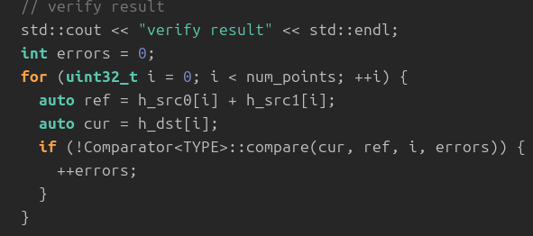
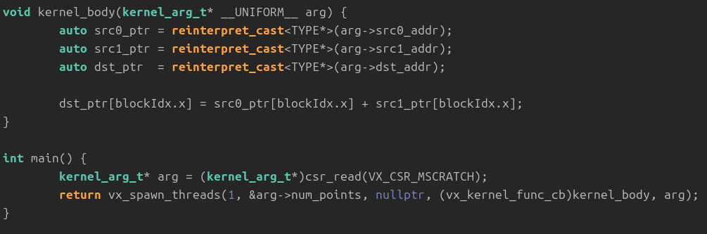
Software Stack
Host Code:
Acts as the orchestrator, it manages the following in the host side:
memory allocation
data transfer
program flow using sequential logic—like a standard for loop that processes data one element at a time
Kernal Code:
Focuses purely on computation. Instead of iterating through data, it defines a single operation that is executed simultaneously across a grid of threads.
In this model, the concept of a loop is replaced by hardware parallelism, where thousands of threads (organized into warps) process individual data elements at the exact same moment.
Notes:
It need host code that is manage operation in the host code like memory allocation, data transfer, and it has program flow like the normal c code.
Also it need kernal code that is will be executed in the vortex hardware so it need a difrente program flow.
--------------------------------------------------------------------------------------------------------------------
And as we said that the comparison is between the cpu output and the vortex output so we need two diffrente codes for each one to be compiled and executed on it.
So we need host code to be responsible to memory allocation, data transfer, and descriping the logical flow using high level language or human readable code like for loop to loop on the vectors in the vector addition function.
While the kernel code it focuss purely on the computation of the function using a logic match the way that the vortex understand which is like using thread index instead of for loop fo the vector addition.

Slide 151
Compilation Flow
Host Code
Compiler
Host
Executable
Lower device communication functions with runtime library
Vortex Runtime
Kernel Code
Front-end compiler
Back-end compiler
IR
Kernel executable
Built-in Library
(e,g. math functions)
Analyze program semantics
Lower functions with built-in library
Vortex
Kernel library
Vortex ISA
Lower IR to Vortex ISA using Vortex intrinsic
Perform vortex-specific optimization
Notes:
For each type of the code there is a compilation flow: For the host code 🡪 simply convert the high level code into assemply code to be executed on the host cpu also as we said that the host code reasponsiple for memory allocations for both cpu and vortex so it need the vortex runtime liprary as a supporter to understand those functions.
For the kernel code 🡪 it has compilation stages front end where it simply convert the kernel code into intermidate code which is lower lang. than the C but still higher that asseamply
While the second stage is the middle end this is where the IR code will be optimized this is the main function of it.
For the Back end compiler it convert the optimized IR code into the final asseamply code that will be executed using vortex so it need the kernal library and the vortex ISA.
----------------------------------------------------------------------------------------------------------------------------------------------------------------------------
For the compilation flow of the Host code is simple as any c code compiled in the cpu but in addition to using some function defined for the vortex like memory allocation as we discussed earlier.
While for the kernel code it need to go through three phases of the compilation: 1) front end compiler: which it use built-in library conatin some predefined math function to convert the high level code into kernel code (indermediate representation)
2) where in this stage the optimization can be done, the intermediate representation is a lowe level lanfuage that c++ but in the same time not like the assembly code in the level. 3) back-end compiler it use the vortex kernel library and the vortex instruction set arch. To mimc the instruction In the kernel code to the instruction set arch. Of the vortex to create the binary representation of the code (or the final assemply code)

Slide 152
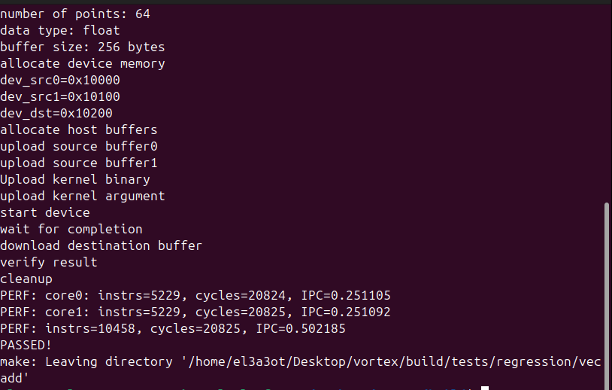
System-Level Sanity Check
Host Code
Kernel Code
Notes:
So we used the vector addition test that is in vortex repo to test the system level sanity .
Here is the part from the host code where it represent the golden model or the function that it will be executed in the cpu and the scoreboard that will check after the vortex write bace the result in the memory allocated by the host code and as we can see that the it use normal for loop while in the kernel code it use one line statement.
And the test passed as the other ones like signed matrix multiplication test.

Slide 153
Unit Decomposition
PROS
Complexity Reduction:
As our focus is to make sure that they are the same functionality after the ASIC conversion currently or even in the optimization phase. So, there is no meaning to create a Testbench for the whole vortex or even optimize the rest of the units and there is a logical error in the main engine of the vortex.
Isolation:
Decouples execution units (ALU, FPU) from the complex top-level hierarchy. This guarantees that failures are due to logic bugs, not system-level interconnect or communication noise
Problem
Solution
Code dependencies:
Because the Vortex RTL is deeply intertwined, extracting a single unit like the ALU breaks links to dozens of shared packages and header files scattered across the repository. Manually tracking these dependencies initially led to a cycle of constant 'File Not Found' errors and unstable simulation environments.
Automated MakeFile:
Instead of manually tracking files, the Makefile automatically identifies and aggregates the precise dependencies required for each specific unit's testbench

Slide 154
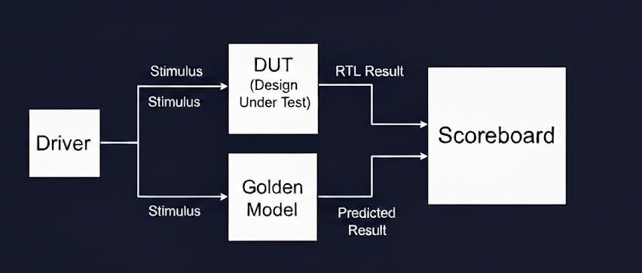
Verification Architecture & Test Plan
Verification Environment
General Verification Plan
Function-Level: Created dedicated test benches for every instruction supported by each block.
Constraint Randomization: Injected randomized input vectors to uncover bugs that human-written tests might miss.

Slide 155
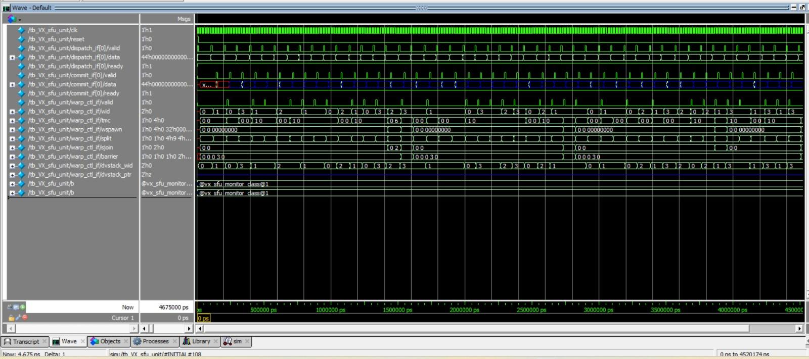
SFU

Slide 156
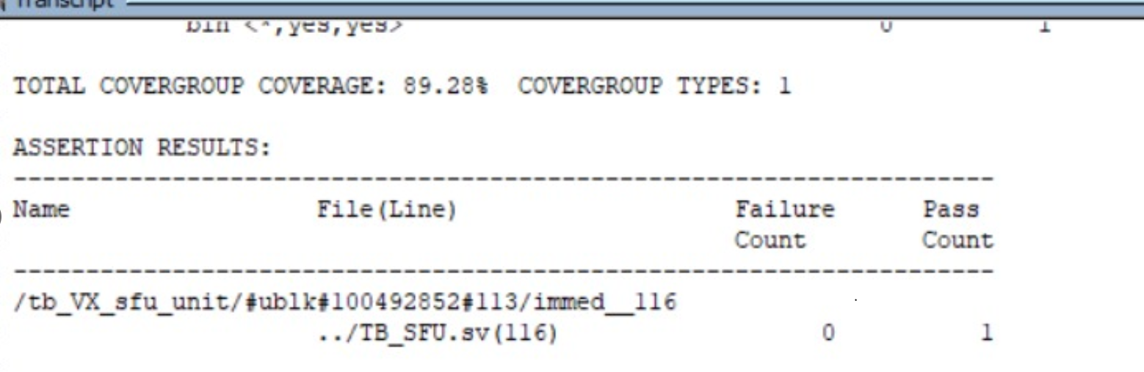

COVERAGE REPORT

Slide 157


COVERAGE REPORT

Slide 158
Verification Roadmap

Slide 159
Next Semester Roadmap (To-Do)
Phase II: Post-Synthesis Verification
GOAL:
Ensure the Synthesized Netlist is logically equivalent to the RTL and that new "Black Box" memory macros function correctly
Action:
LEC to verify that RTL == Netlist to catch synthesis bugs.
Macro Integration: Update the testbench hierarchy to replace behavioral models with hard macros and run sanity checks.
Phase III: Physical Verification
Action:
Debug uninitialized states ("X" values) that cause system hangs.
Load timing delays to verify the chip works at the target frequency
GOAL:
Validate the design under "real-world" conditions, detecting X-propagation issues and confirming timing constraints..

Slide 160
Next Semester Roadmap (To-Do)
Phase IV: Optimization & Signoff
Action:
Regression Testing: Run full test suites on optimized version to prevent functional regressions.
Performance Benchmarking: Measure Cycle Counts of the optimized design to prove actual speedup against the baseline.
GOAL:
Support the Microarchitectural Optimization phase by ensuring stability and quantifying performance gains..

Slide 161
References
[1] Tor M Aamodt, Wilson Wai Lun Fung, and Timothy G Rogers. General-Purpose Graphics Processor Architecture. Synthesis Lectures on Computer Architecture. Mor-gan & Claypool Publishers, 2018.
[2] John L. Hennessy and David A. Patterson. Computer Architecture: A QuantitativeApproach. Morgan Kaufmann, San Francisco, CA, 5 edition, 2011.
[3] Georgia Tech University. A general-purpose gpu accelerator. https://github.com/vortexgpgpu/vortex, 2023..
[4] S. Dublish, V. Nagarajan, and N. Topham, “Characterizing mem-ory bottlenecks in GPGPU workloads,” in Proc. 2016 IEEE Int.Symp. Workload Characterization (IISWC), 2016. [Online].

Slide 162
References
[5] F. Elsabbagh, B. Asgari, H. Kim, and S. Yalamanchili, "Vortex RISC-V GPGPU System: Extending the ISA, Synthesizing the Microarchitecture, and Modeling the Software Stack," in Proc. 3rd Workshop Comput. Archit. Res. with RISC-V (CARRV), Phoenix, AZ, USA, Jun. 2019. [Online]. Available: https://carrv.github.io/2019/papers/carrv2019_paper_10.pdf
[6] F. Elsabbagh et al., "Vortex: A Reconfigurable RISC-V GPGPU Accelerator for Architecture Research," Georgia Institute of Technology, [Poster], 2021. [Online]. https://vortex.cc.gatech.edu/publications/hotchips-poster.pdf.
[7] F. Elsabbagh et al., "Vortex: Open Source RISC-V GPGPU Accelerator," Feb. 2020. [Online]. Available: https://arxiv.org/pdf/2002.12151.

Slide 163
Thanks!!

